Slide 1
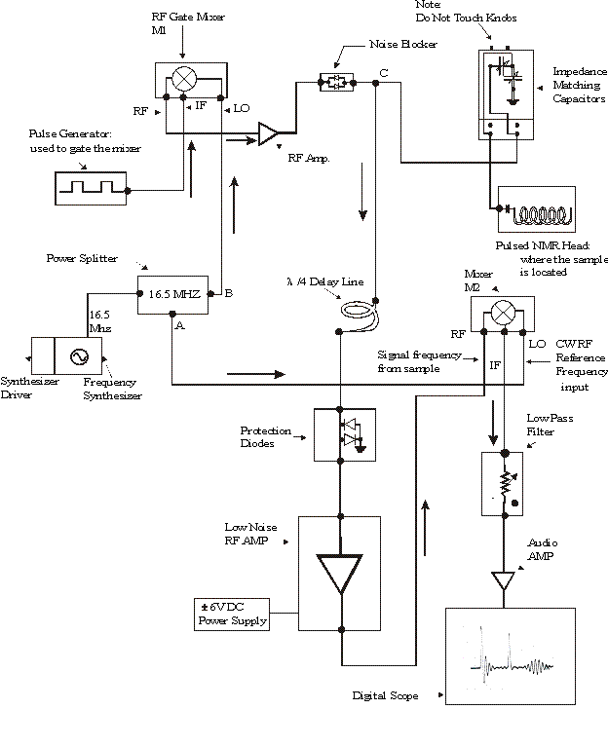
NUS-Pulse Programming in Bruker

Slide 2
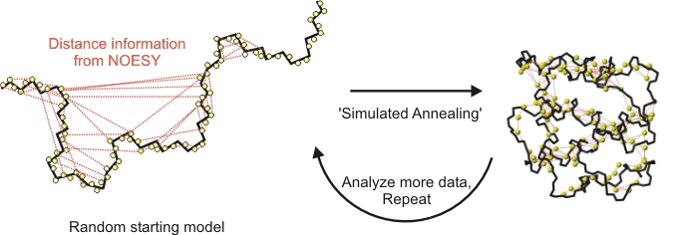
Structure Determination by NMR

Slide 3
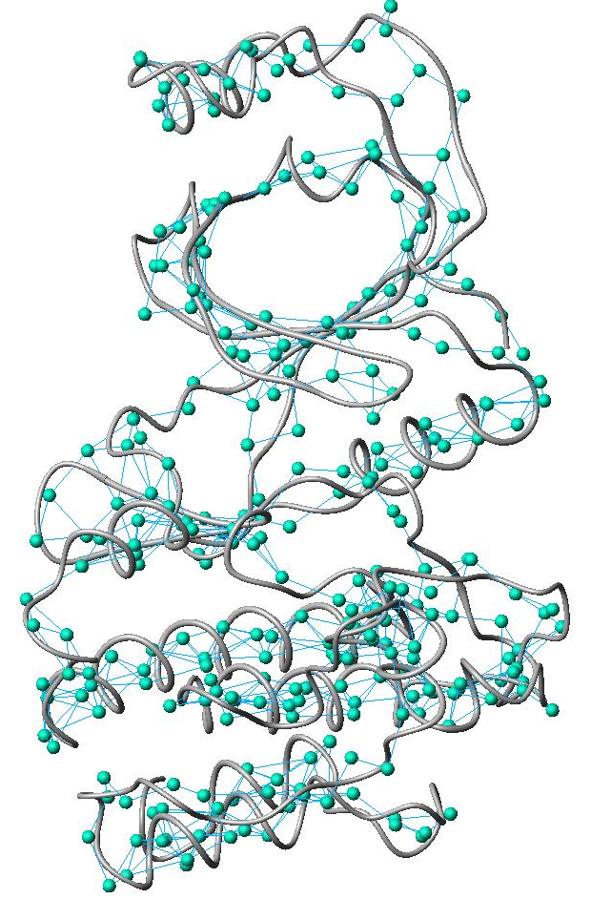
NH-HN NOESY restraints

Slide 5
So what is the problem?

Slide 6
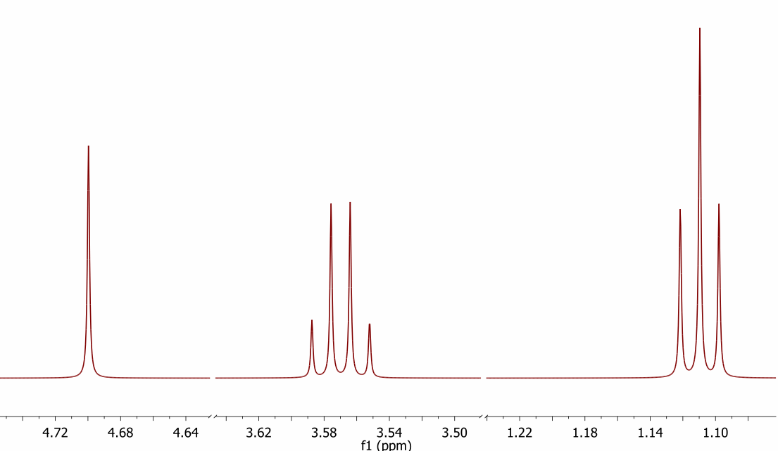

Slide 7
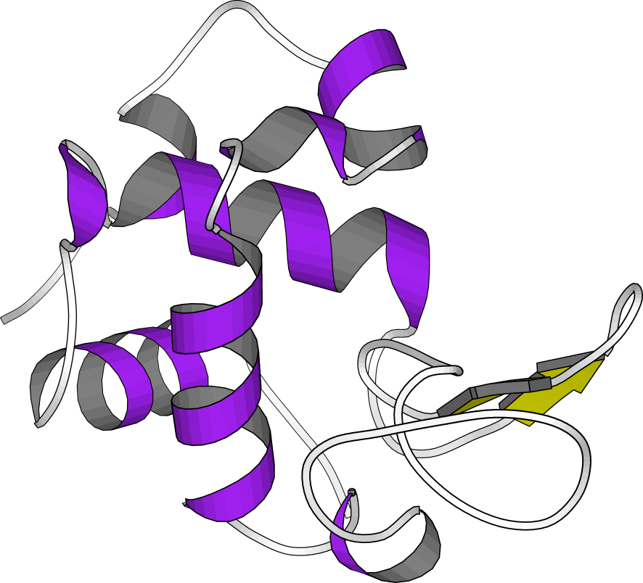
Protein Structure Determination
Lysozyme: FW=14.3 kDa: 2330 atoms
129 amino acid residues

Slide 8
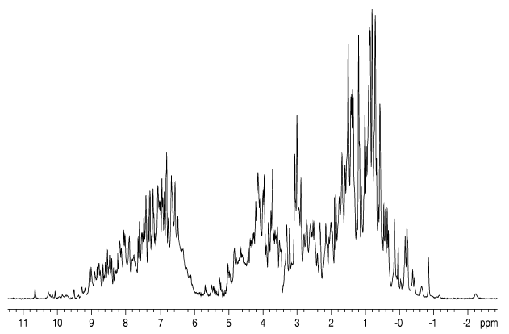
1D ¹H spectra of Lysozyme(14.3 kDa)
1217 ¹H signals

Slide 10
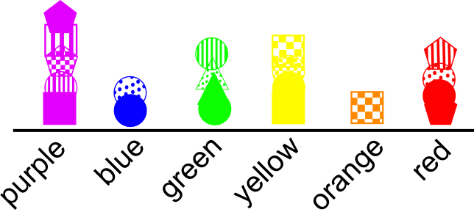

Slide 11
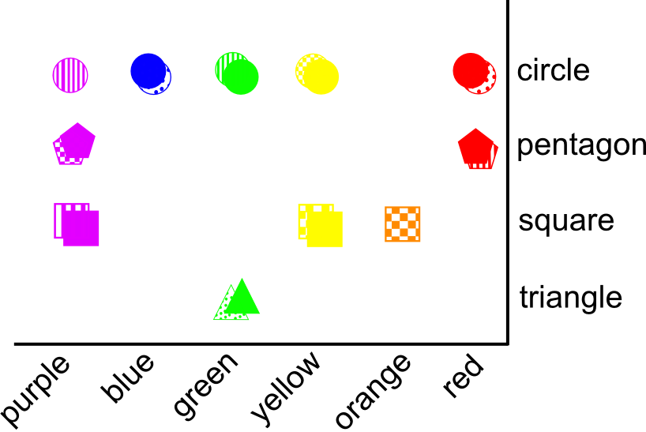

Slide 12
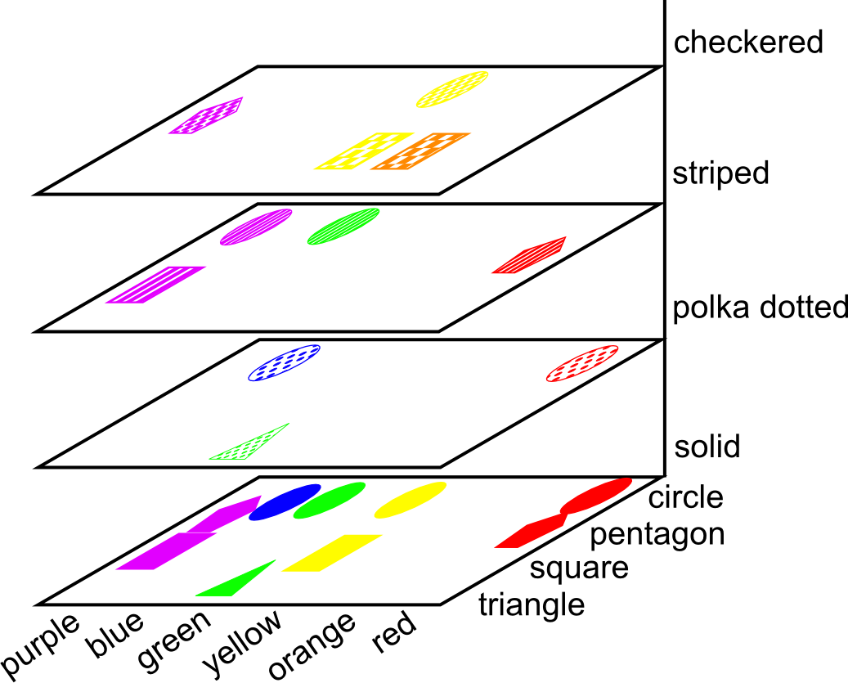

Slide 13
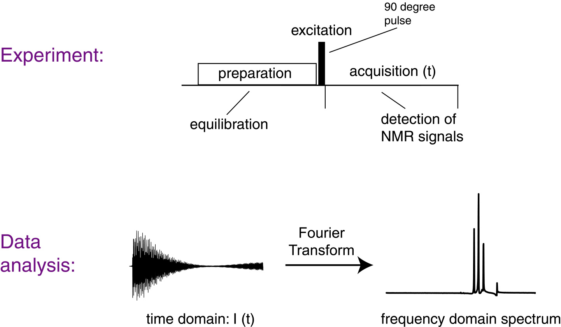
Pulsed One-Dimensional FTNMR Experiment

Slide 14
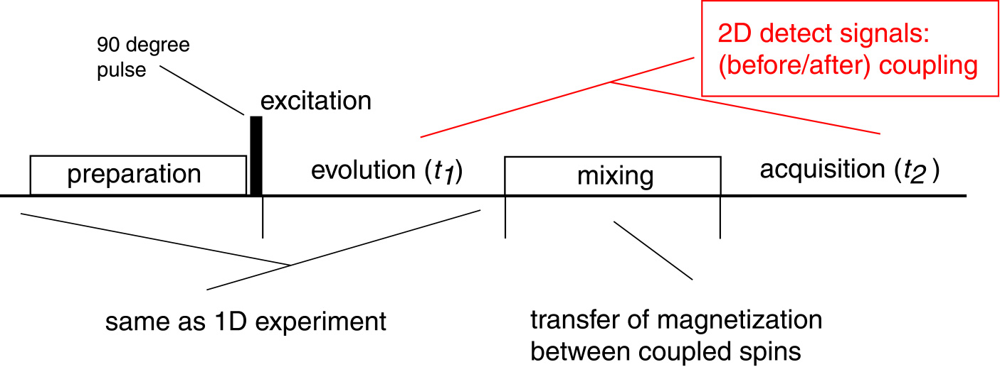
Two-Dimensional NMR Spectroscopy.
Utilize Nuclear Couplings
t1
t2
t1
t2
Through-bond (J, scalar)
Through-space (dipolar)

Slide 15
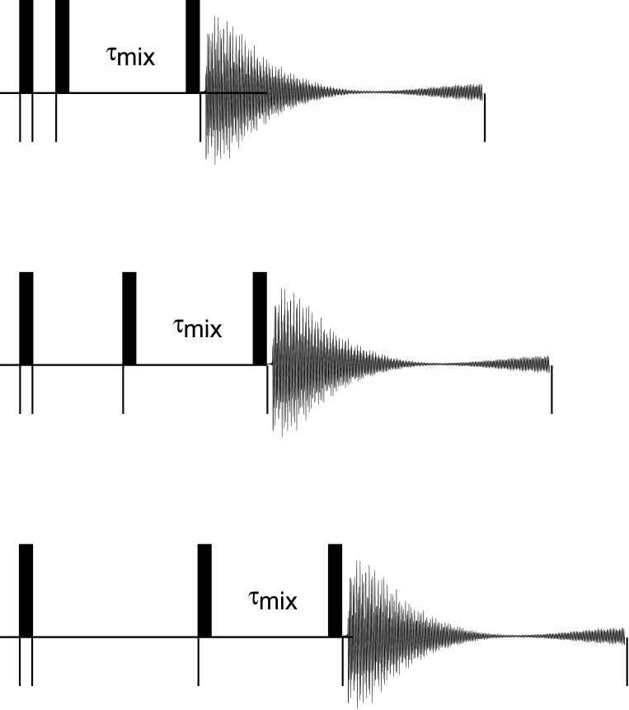
Two-Dimensional NMR Spectroscopy.
Experimental Scheme
Array evolution time (t₁); acquire spectra for each t₁ value
Evolution (t₁): arrayed

Slide 16
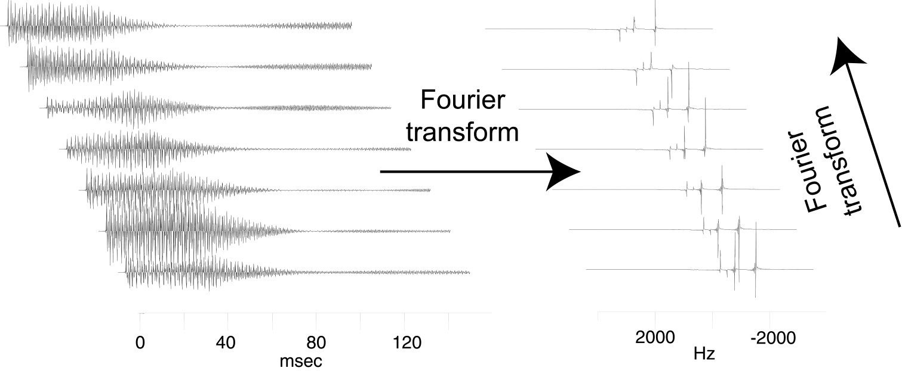
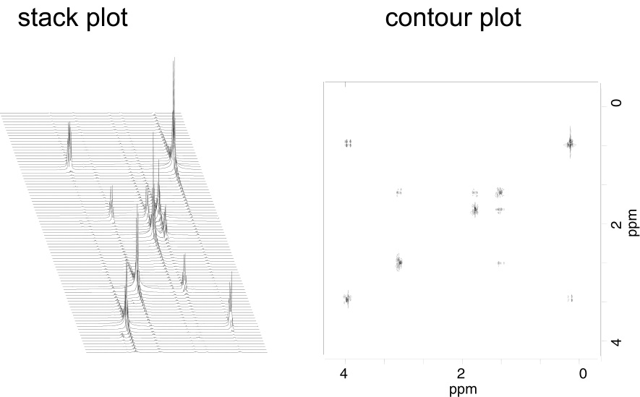
Two-Dimensional NMR Spectrum

Slide 17
16 s

Slide 18
256 pts
16 s
2 hours

Slide 19
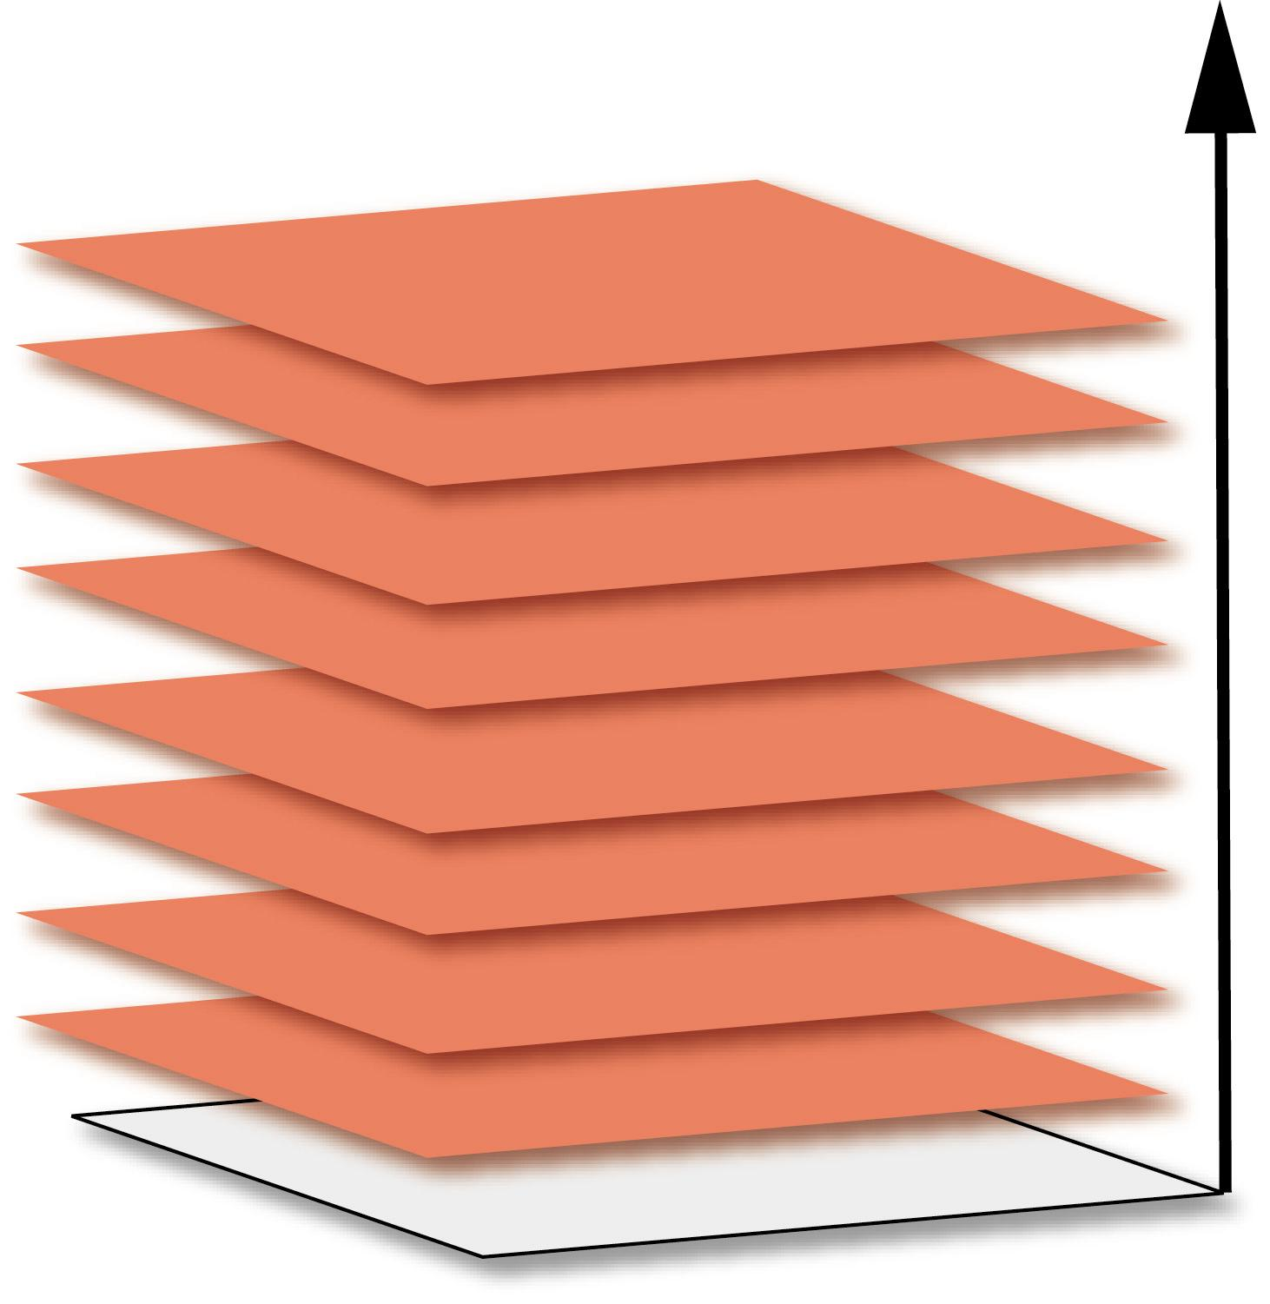
64 pts
128 hours ~ 5 days

Slide 20
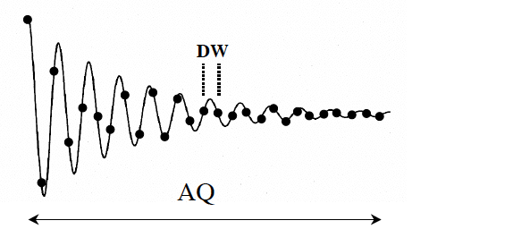
Increment in the indirect dimension is given by the Nyquist
Theorem DW=1/2*SW
Resolution depends upon the acquisition time. (and relaxation)
Measurement time depends upon the number of steps (number of experiments)

Slide 21
Non-linear sampling routines
High-field – High resolution paradox

Slide 22
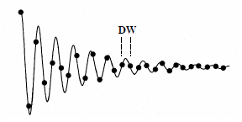
Longer Acquisition
Better Resolution
Indirect dimension 2
Indirect dimension 1
Direct dimension
free
Nyquist Theorem states
DW = 1/ 2 * SW

Slide 23
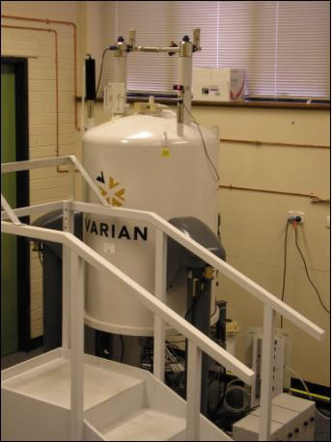
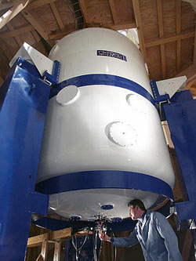
500 MHz
900 MHz
Triple Resonance
HNCA
¹H-¹⁵N-¹³C
 | Nitrogen | Carbon
Frequency | 50 MHz | 125 MHz
Spectral Width ppm | 36 ppm | 32 ppm
Spectral Width Hz | 1823 Hz | 4029 Hz
Number of points | 48 points | 128 points
Resolution | 38 Hz | 31.5 Hz
 | Nitrogen | Carbon
Frequency | 90 MHz | 225 MHz
Spectral Width ppm | 36 ppm | 32 ppm
Spectral Width Hz | 3285 Hz | 7256 Hz
Number of points | 48 points | 128 points
Resolution | 68 Hz | 56 Hz
Total acquisition time 34 hours (16 scans)

Slide 24
500 MHz
900 MHz
Triple Resonance
HNCA
¹H-¹⁵N-¹³C
 | Nitrogen | Carbon
Frequency | 50 MHz | 125 MHz
Spectral Width ppm | 36 ppm | 32 ppm
Spectral Width Hz | 1823 Hz | 4029 Hz
Number of points | 48 points | 128 points
Resolution | 38 Hz | 31.5 Hz
 | Nitrogen | Carbon
Frequency | 90 MHz | 225 MHz
Spectral Width ppm | 36 ppm | 32 ppm
Spectral Width Hz | 3285 Hz | 7256 Hz
Number of points | 88 points | 230 points
Resolution | 38 Hz | 31.5 Hz
Total acquisition time on the 900MHz 106 hours (16 scans)

Slide 25
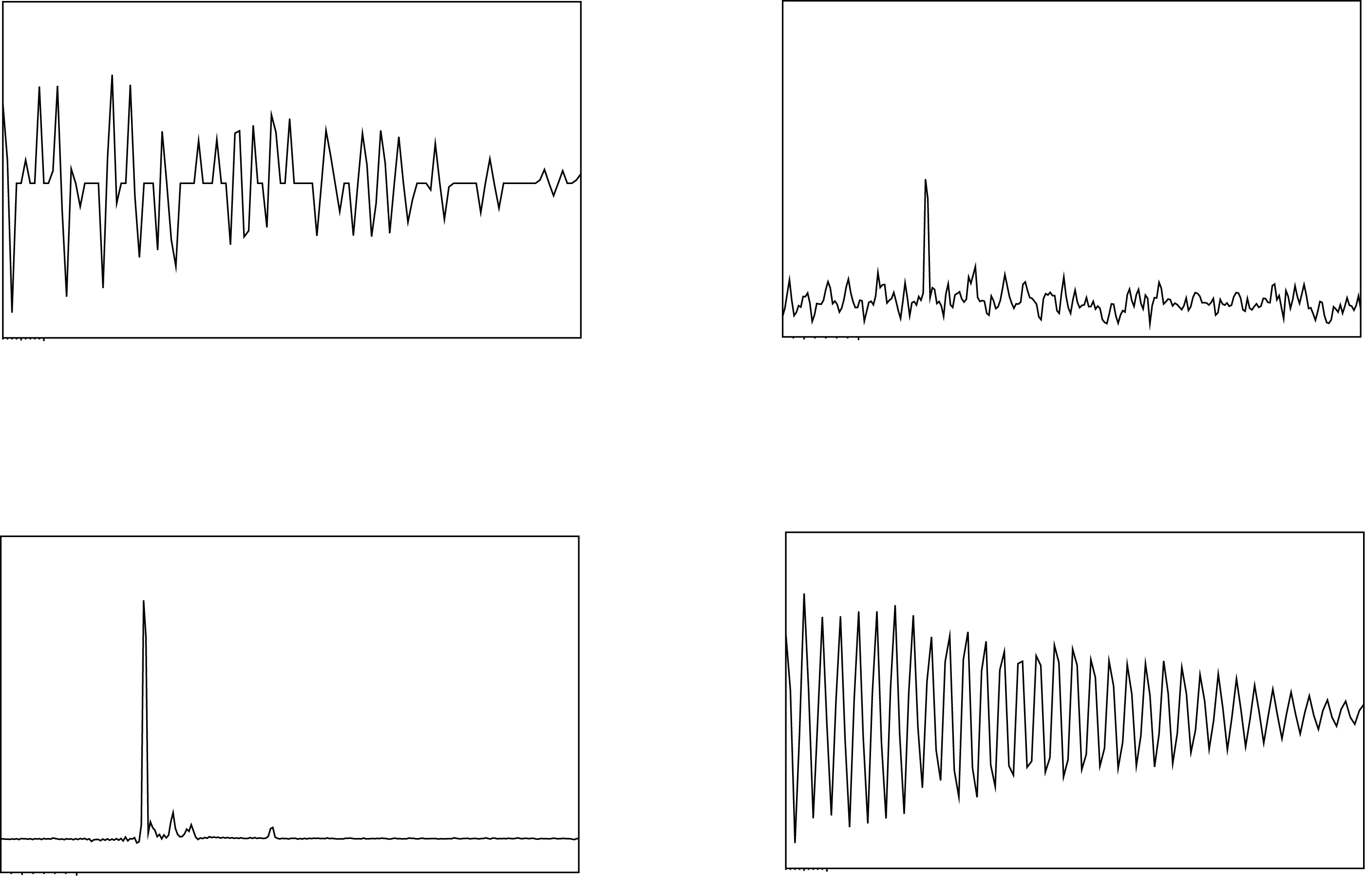
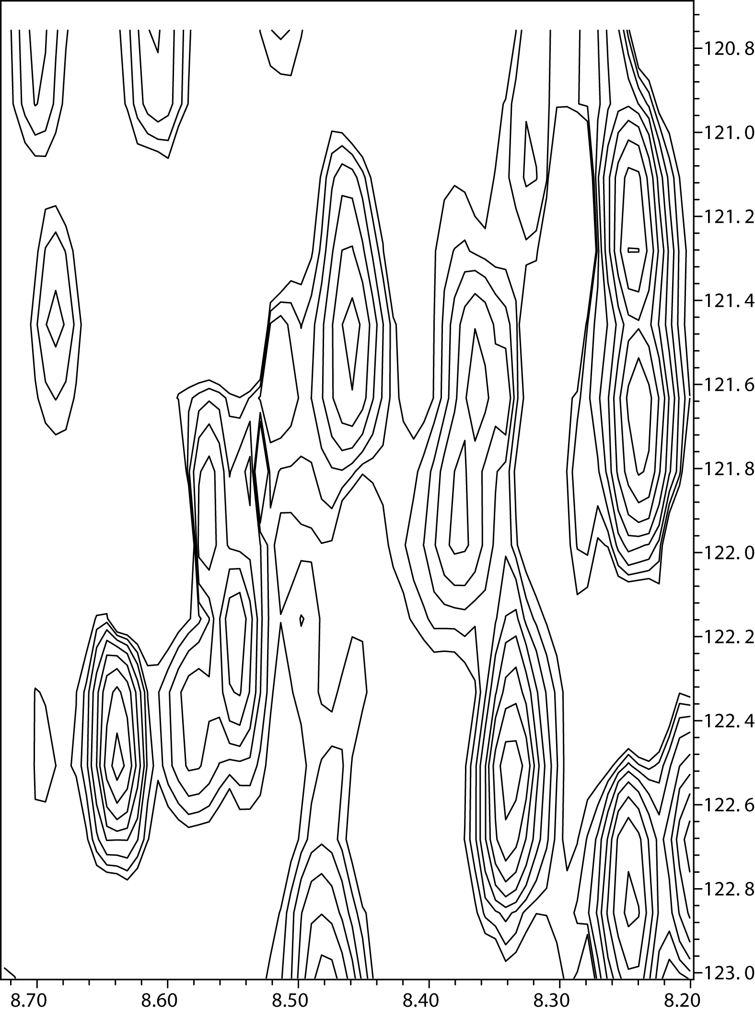
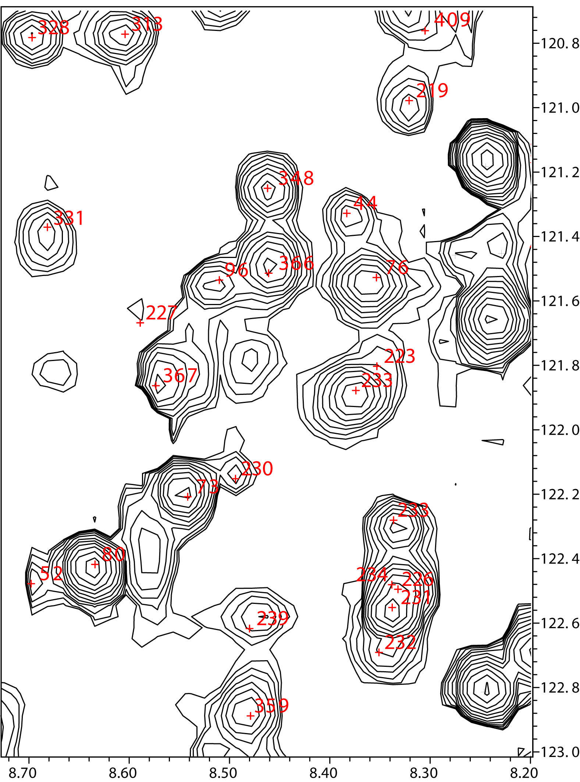
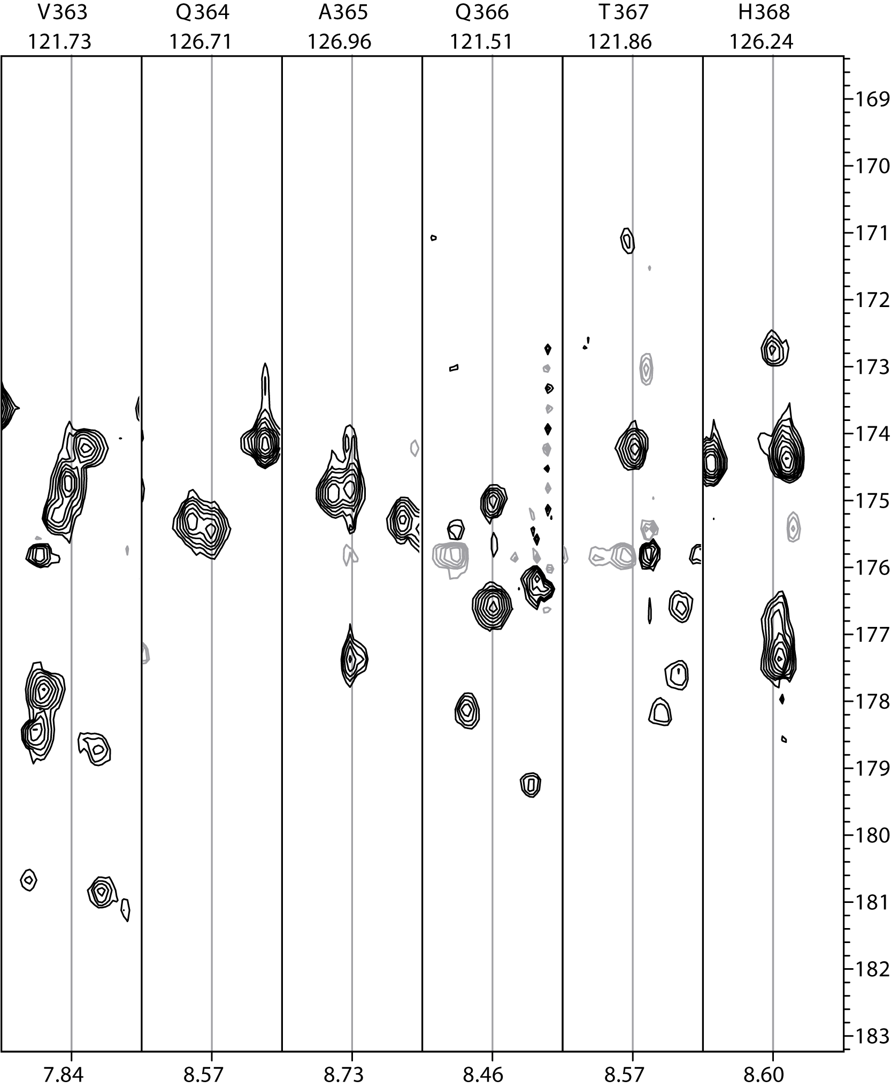
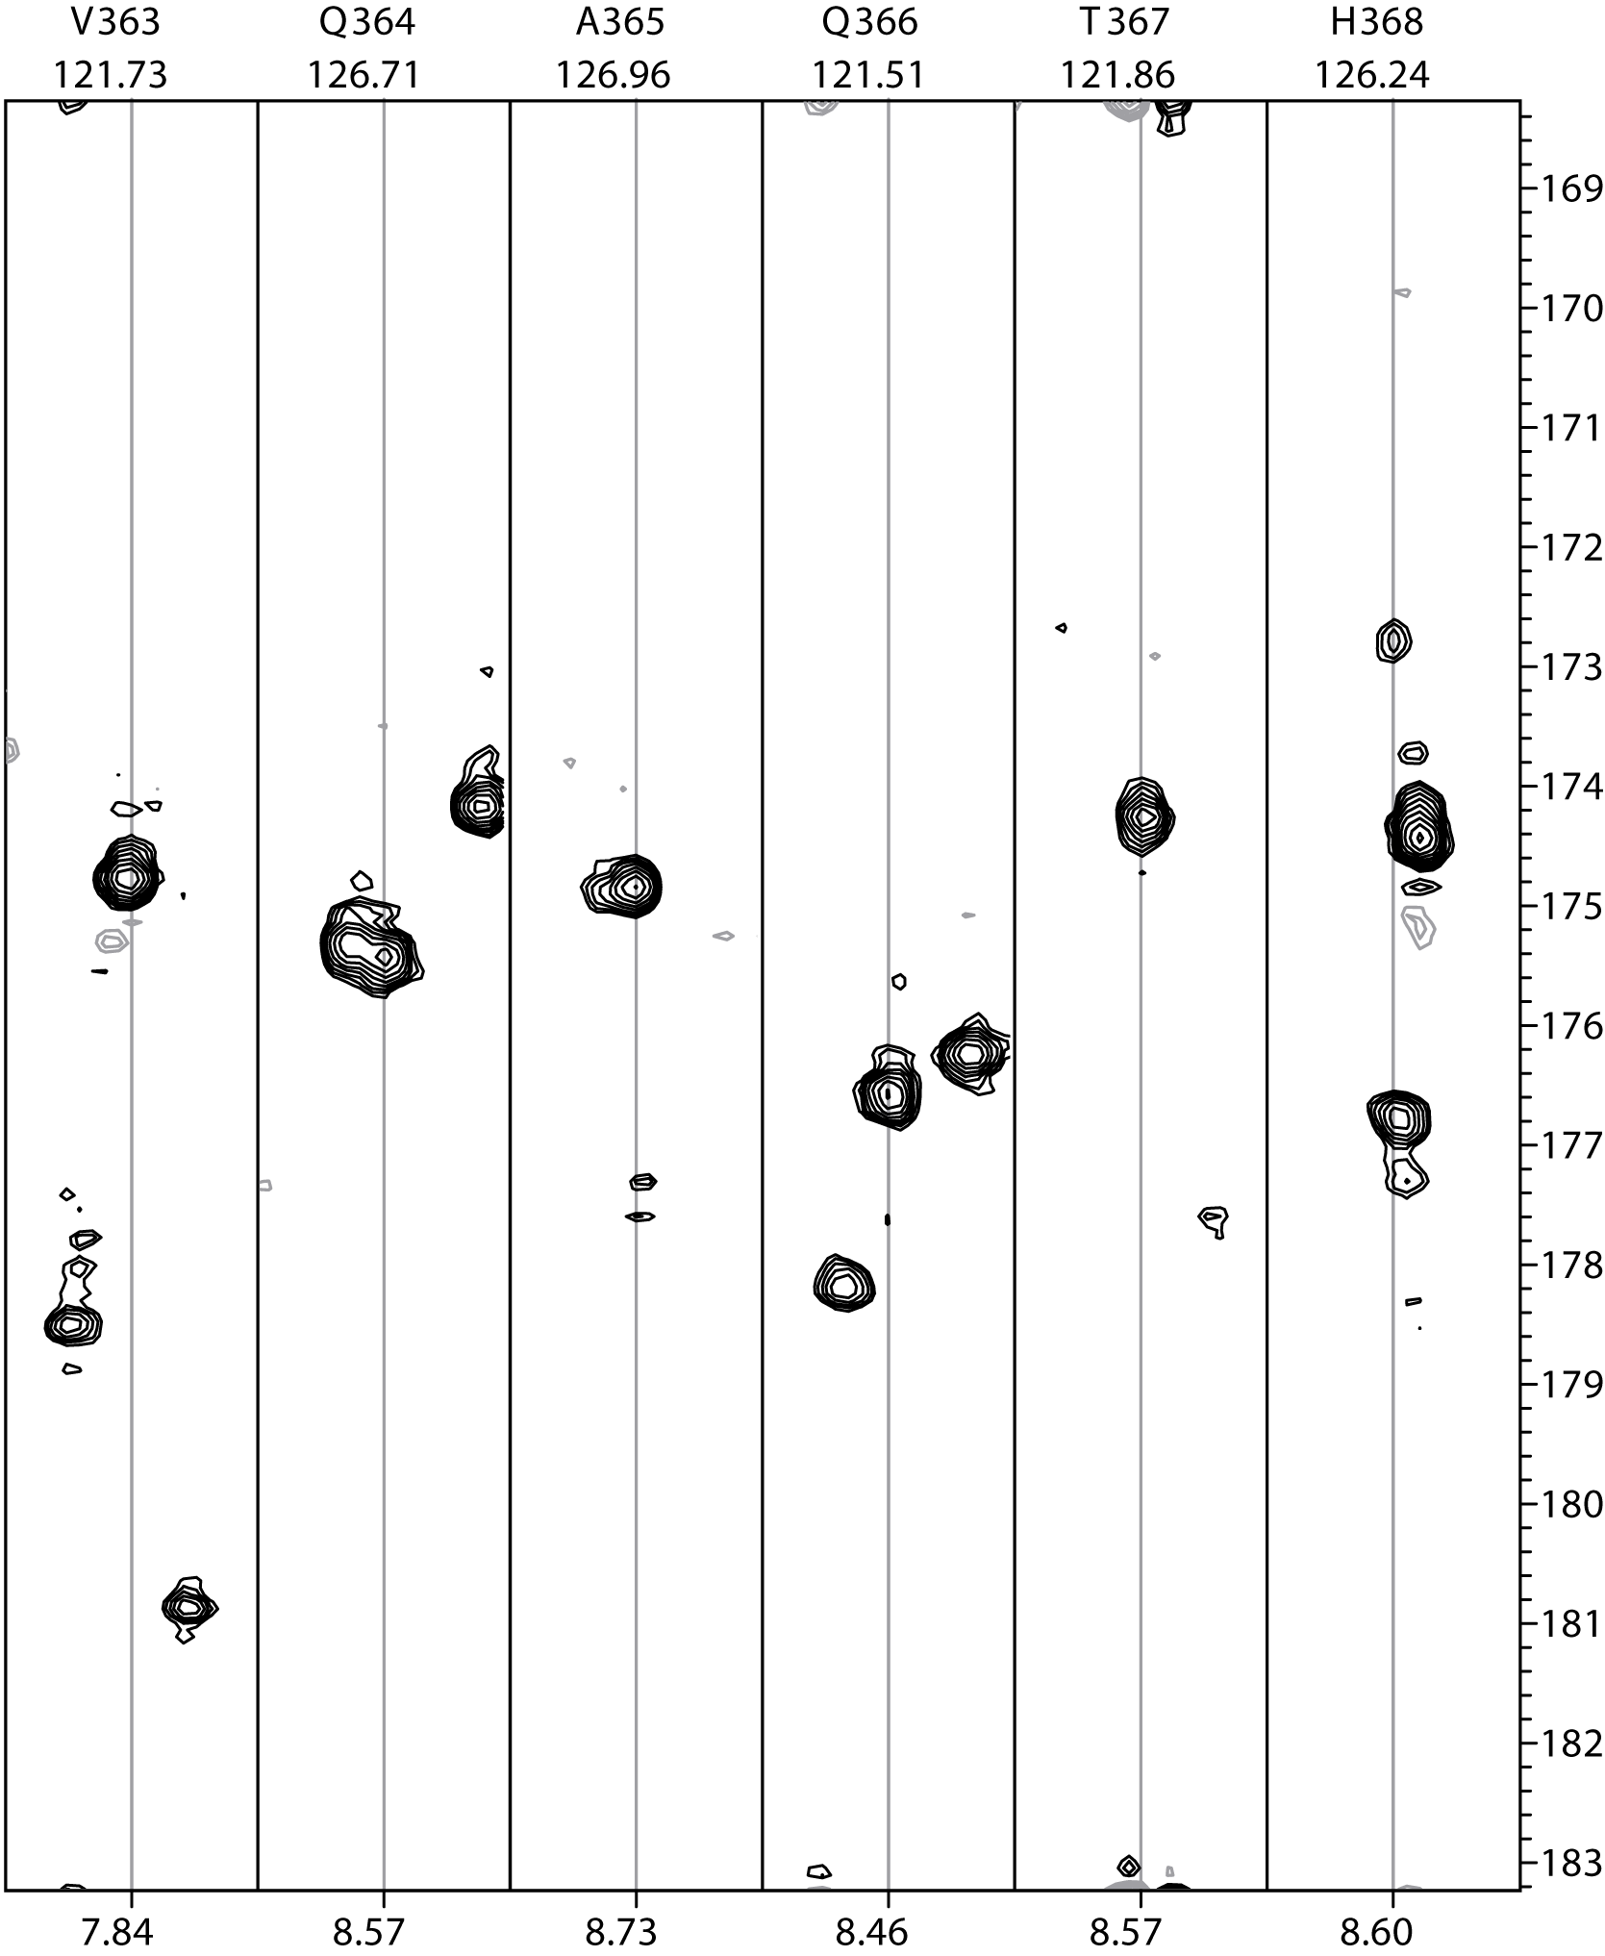
FM reconstructed non-linear and linear 3D HNCO of 50 kDa EntF C-domain (900 MHz, 0.3 mM, 6 hours each) τ_{c} ~20-24 ns
linear
3D HNCO
grad Q(f)
FFT⁻¹
Non-linear
3D HNCO
linear
Non-linear
N
C’
H^{N}
Linear grid
N:50
C:25
1250 sampling points
Non-linear grid
N:400
C:100
40,000 grid points
1250 sampled
3% of grid points sampled
H^{N}
H^{N}
H^{N}

Slide 26
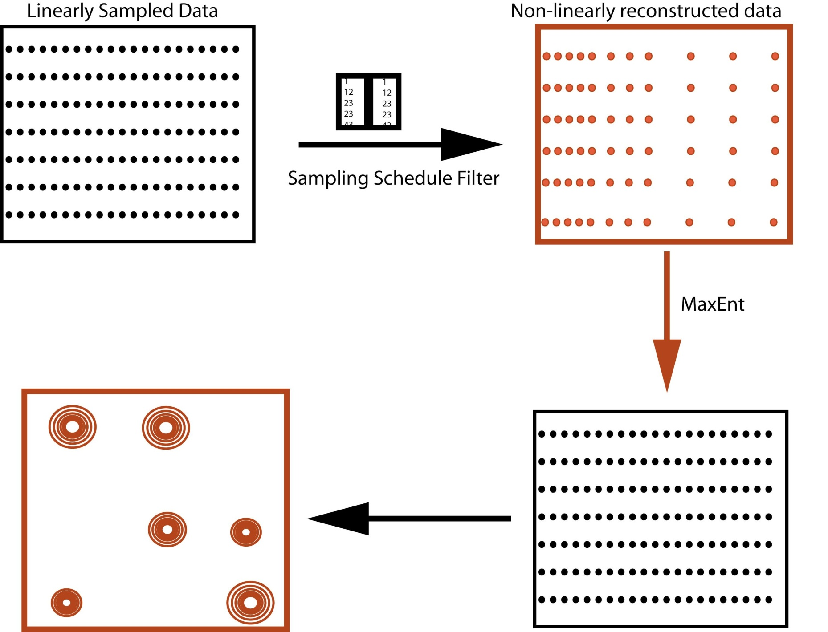
Non-linear Pulse programming
Reconstruction
FM, Max-Ent,MDD

Slide 27
¹⁵N
¹³C
DW ¹³C
Real
Imaginary
Real
Imaginary
DW ¹⁵N

Slide 28
¹⁵N
¹³C
DW ¹³C
2,1
1,1
1,2
1,3
1,4
X
1,7
DW ¹⁵N

Slide 29
Setting up NUS
Choose a Pulse program, setup Linear, optimize.
Decide on the sampling density and the extent you want to go into each dimension.
Make schedule.
Run NUS version of the experiment.
Reconstruct data

Slide 30
HNCA/HNCOCA
HNCACB/HNCOCACB
HNCO/HNCACO
HCCONH
CCCONH
hNcaNH
¹⁵N dispersed TOCSY
¹⁵N dispersed NOESY 3D
¹⁵N dispersed NOESY 4D
Timeshared NOESY (15N/13C) 3D/4D
RDC HNCO based
HCCH TOCSY
¹³C dispersed NOESY
Aromatic assignments

Slide 31
Various types of coding strategies used in the Wagner lab
Pre-calculated Delays and Phases (using a vdlist)
Stop Reset and Go (using a vclist)
Incremental delays and phases (using a vclist)

Slide 32
Pulse sequences consist of
1)Pulses/Gradients
2)Delays
that is it…
and nothing else*…..
*maybe acquisition and machine related commands

Slide 33
The Actual Pulse Sequence
;zg ;avance-version (02/05/31) ;1D sequence #include <Avance.incl> 1 ze 2 30m d1 p1 ph1 go=2 ph31 30m mc #0 to 2 F0(zd) exit ph1=0 2 2 0 1 3 3 1 ph31=0 2 2 0 1 3 3 1 ;pl1 : f1 channel - power level for pulse (default) ;p1 : f1 channel - high power pulse ;d1 : relaxation delay; 1-5 * T1 ;NS: 1 * n, total number of scans: NS * TD0 ;$Id: zg,v 1.7 2002/06/12 09:05:19 ber Exp $
reset scan counter
enable execution of dummy scan
reset phase pointers
Execute data acquisition
loop to line number 2 until “ns” scans
receiver phase controlled by ph31

Slide 34
1D to 2D
Array evolution time (t₁); acquire spectra for each t₁ value
Evolution (t₁): arrayed

Slide 35
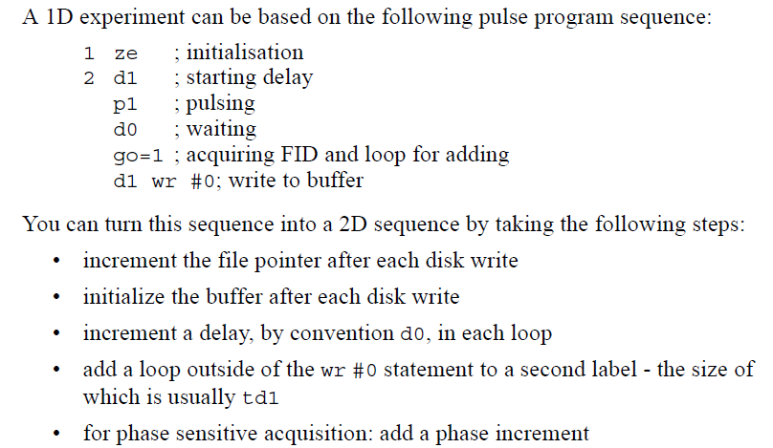
1D to 2D
Taken From Bruker Pulse Program Manual

Slide 36
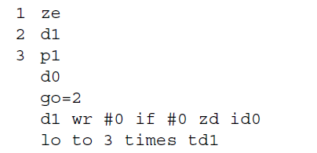
1D to 2D
Old Style
Increment d0
New Style mc statements

Slide 37
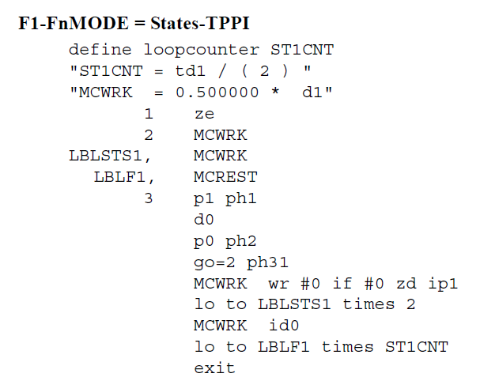
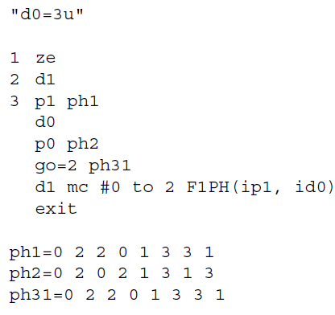
1D to 2D
Attention must be paid to the Fn-Mode in eda if you are using mc statements

Slide 38
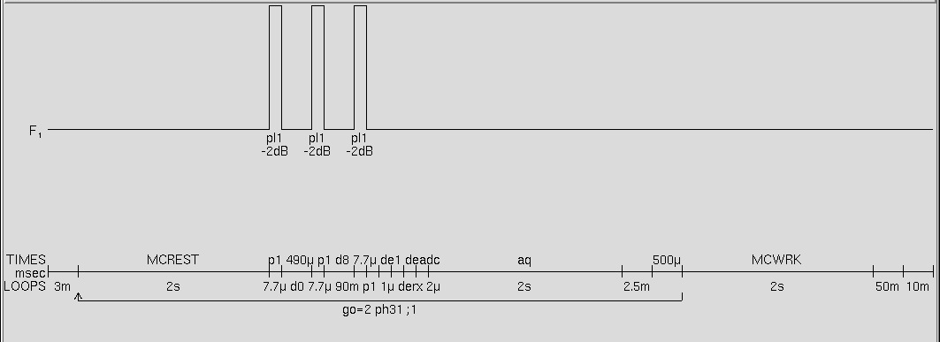
2D NOESY

Slide 39
Changing Phases
ph3 = 0 2 2 0
ip3
ph3 = 1 3 3 1
90⁰ phase shift
ip3*2
180⁰ phase shift

Slide 40
CONDITIONS AND LOOPS

Slide 41
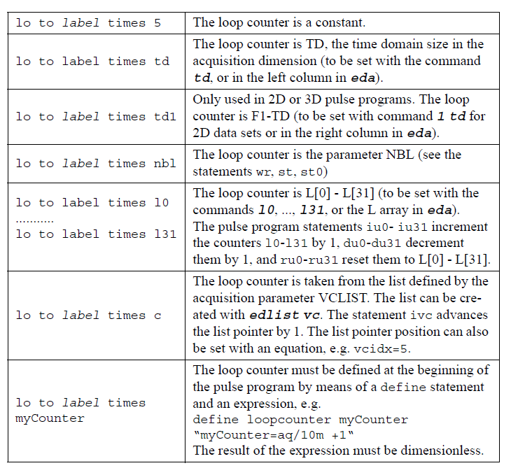
Loop Statements
Taken From Bruker Pulse Program Manual

Slide 42
d12 pl15:f2 ;begin DIPSI2 7 (p9*3.556 ph23):f2 (p9*4.556 ph25):f2 (p9*3.222 ph23):f2 (p9*3.167 ph25):f2 (p9*0.333 ph23):f2 (p9*2.722 ph25):f2 (p9*4.167 ph23):f2 (p9*2.944 ph25):f2 (p9*4.111 ph23):f2 (p9*3.556 ph25):f2 (p9*4.556 ph23):f2 (p9*3.222 ph25):f2 (p9*3.167 ph23):f2 (p9*0.333 ph25):f2 (p9*2.722 ph23):f2 (p9*4.167 ph25):f2 (p9*2.944 ph23):f2 (p9*4.111 ph25):f2 (p9*3.556 ph25):f2 (p9*4.556 ph23):f2 (p9*3.222 ph25):f2 (p9*3.167 ph23):f2 (p9*0.333 ph25):f2 (p9*2.722 ph23):f2 (p9*4.167 ph25):f2 (p9*2.944 ph23):f2 (p9*4.111 ph25):f2 (p9*3.556 ph23):f2 (p9*4.556 ph25):f2 (p9*3.222 ph23):f2 (p9*3.167 ph25):f2 (p9*0.333 ph23):f2 (p9*2.722 ph25):f2 (p9*4.167 ph23):f2 (p9*2.944 ph25):f2 (p9*4.111 ph23):f2 lo to 7 times l1
Example of a loop
TOCSY Spin lock

Slide 43
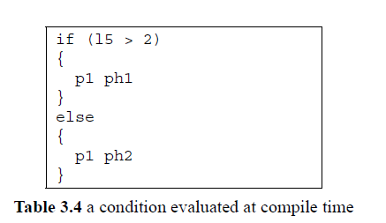
Conditionals .. IFs
Example1
Taken From Bruker Pulse Program Manual

Slide 44
Example 2
if "l7 %2 == 1" goto 20 d12 pl28:f1 ;for SATURATION goto 21 20 d12 pl30:f1 ;for REFERENCE
21…..beginning of pulse sequence.
Example 3
(p21 ph3):f3 d0 # ifdef LABEL_CN (center (p2 ph7) (p8:sp13 ph1):f2 ) # else (p2 ph7) # endif /*LABEL_CN*/ d0 p16:gp2*EA d16

Slide 45
¹⁵N
¹³C
DW ¹³C
2,1
1,1
1,2
1,3
1,4
X
1,7
DW ¹⁵N

Slide 46
Various types of coding strategies used in the Wagner lab
Pre-calculated Delays and Phases (using a vdlist)
Stop Reset and Go (using a vclist)
Incremental delays and phases (using a vclist)

Slide 47
Various types of coding strategies used in the Wagner lab
Imported courtesy of Sebastian Hiller
Pre-calulated Delays and Phases (using a vdlist)‏
(p13:sp2 ph4):f2
d0
(center (p14:sp5 ph1):f2 (p22 ph8):f3 )‏
d0
4u
(p14:sp3 ph1):f2
...
F1PH(rd10 & rd30 & ip4, id0)‏
(p13:sp2 ph4):f2
vd
(center (p14:sp5 ph1):f2 (p22 ph8):f3 )‏
vd
4u ivd
(p14:sp3 ph1):f2
...
4u ip4
lo to 3 times 2
4u rp4
90 4u ip31*2
4u ip4*2
lo to 90 times c
4u ivc

Slide 48
Pre-calulated Delays and Phases (using a vdlist)‏
Advantage: Simpler pulse program
- replace variable delays with “vd” followed by “ivd”
- no need to reset the variable delays,
random order for sampling
- variable phases are read in from vclist
(1,2) => (0, 180) for states-TPPI
Disadvantage: experiment specific vd list
- must translate sampling schedule into vd-list
in pulse program-dependent “arbitrary” format
(number of delays, value of delays)‏
- different sweep widths require different vd-list
- difficult to recover sampling schedule from vd-list

Slide 49
Pre-calulated Delays and Phases (using a vdlist)‏
>runspheader -in nls.in
NDIM 4
SPARSE y
seed 4321
sptype shuffle
MINHOLE 0
f180 nnnn
CT_SP nnnn
CEXP nnnn
NIMAX 100 64 48 1
NIMIN 0 0 0 0
NI 50 30 30 1
SW 8000 2500 2199.98 12004.8
T2 0.02 0.008 0.016 1
Jsp 0 0 0 0
“nls.hdr_3”
2 35 8
20 23 36
17 31 37
13 34 20
12 11 3
5 3 27
13 10 29
16 13 7
23 6 4
24 17 37
2 25 11
13 3 9

Slide 50
Pre-calulated Delays and Phases (using a vdlist)‏
>MakeNUSlists
vd list
vc list
0.000000
0.000000
0.000000
0.000000
0.000000
0.000278
0.000000
0.000000
0.000556
0.000000
0.000000
0.000833
0.000000
0.000000
0.001111
0.000000
0.000000
0.001389
0.000000
0.000000
0.001667
0.000000
0.000000
0.001944
1
1
1
1
1
2
1
1
1
1
1
2
1
1
1
1
1
2
1
1
1
1
1
2
nls_delays
nls_phases
X

Slide 51
Pre-calulated Delays and Phases (using a vdlist)‏
Caution
- make sure you include point “0 0 0” in your sampling schedule
- limit of constant time must be taken into account
prior to generating vd list

Slide 52
One more thing… kinda important
(p13:sp2 ph4):f2
vd
(center (p14:sp5 ph1):f2 (p22 ph8):f3 )‏
vd
4u ivd
(p14:sp3 ph1):f2
...
…..
…..
…..
…..
Real
Imaginary
Echo
Anti-Echo

Slide 53
2 1m
"vdidx=l3"
10u do:f2
d1
20u LOCKH_ON
….
….
….
(p13:sp2 ph4):f2
vd
(center (p14:sp5 ph1):f2 (p22 ph8):f3 )‏
vd
4u ivd
(p14:sp3 ph1):f2
….
….
10u igrad EA
lo to LBLEA2 times 2
10u ip7
10u ip8
lo to LBLSTS1 times 2
10u iu3
10u iu3
0
0
1
0
0
2
0
0
3
0
0
4
0
1
0
0
1
2

Slide 54
Various types of coding strategies used in the Wagner lab
Pre-calculated Delays and Phases (using a vdlist)
Stop Reset and Go (using a vclist)
Incremental delays and phases (using a vclist)

Slide 55
¹⁵N
¹³C
DW ¹³C
2,1
1,1
1,2
1,3
1,4
X
1,7
DW ¹⁵N

Slide 56
VC list
Sched
1
1
1
2
1
4
1
7
1
9
1
11
2
1
2
2
2
5
1 ,1
1, 2
1, 4
1, 7
1, 9
1, 11
2, 1
2, 2
2, 5
.
.
.
.
.
sched2vc

Slide 57
Non-linear Pulse programming
;non-linear starts here if (l20 == 3) { d11 do:f3 wr #0 if #0 zd d12 ip9*2 d12 iu0 lo to 3 times 2 d12 ip10 d12 ip11 lo to 3 times 2 ;resetting everything d12 rd10 d12 rd30 d12 rp10 d12 rp11 d12 rd0 d12 rp31 d12 rp9 d12 ru0 d12 rp7 d12 rp8 91 d12 id10 d12 dd30 d12 ip7*2 d12 ip8*2 d12 ip31*2 lo to 91 times c
d12 ivc 92 d12 id0 d12 ip10*2 d12 ip11*2 d12 ip31*2 lo to 92 times c d12 ivc lo to 3 times l10 } ;non-leniar ends here else { d11 mc #0 to 2 F1PH(rd10 & rd30 & ip10 & ip11, id0) F2EA(ip9*2 & iu0, id10 & dd30 & ip7*2 & ip8*2 & ip31*2) }
Originally coded by Jim Sun & Dave Rovynyak

Slide 58
Non-linear Pulse programming
VC list
;non-linear starts here if (l20 == 3) { d11 do:f3 wr #0 if #0 zd d12 ip9*2 d12 iu0 lo to 3 times 2 d12 ip10 d12 ip11 lo to 3 times 2 ;resetting everything d12 rd10 d12 rd30 d12 rp10 d12 rp11 d12 rd0 d12 rp31 d12 rp9 d12 ru0 d12 rp7 d12 rp8 91 d12 id10 d12 dd30 d12 ip7*2 d12 ip8*2 d12 ip31*2 lo to 91 times c
d12 ivc 92 d12 id0 d12 ip10*2 d12 ip11*2 d12 ip31*2 lo to 92 times c d12 ivc lo to 3 times l10 } ;non-leniar ends here { d11 mc #0 to 2 F1PH(rd10 & rd30 & ip10 & ip11, id0) F2EA(ip9*2 & iu0, id10 & dd30 & ip7*2 & ip8*2 & ip31*2) }
1
1
1
2
1
4
1
7
1
9
1
11
2
1
2
2
2
5
Originally coded by Jim Sun & Dave Rovynyak

Slide 59
Advantages.
One schedule can be used on different spectrometers and different spectral width.
The schedule is stored for future reconstruction purpose.
Ability to randomize.
Disadvantage
Gives a TCU error for longer increments.
Example
92 d12 id0 lo to 92 times c

Slide 60
Various types of coding strategies used in the Wagner lab
Pre-calculated Delays and Phases (using a vdlist)
Stop Reset and Go (using a vclist)
Incremental delays and phases (using a vclist)

Slide 61
VC list
Sched
0
1
0
2
0
3
0
2
0
2
1
0
0
1
0
3
1 ,1
1, 2
1, 4
1, 7
1, 9
1, 11
2, 1
2, 2
2, 5
.
.
.
.
.
sched4vc

Slide 62
;hsqcf3gpph19 ;avance-version (02/05/31) ;HSQC ;2D H-1/X correlation via double inept transfer ;phase sensitive ;with decoupling during acquisition ;using f3 - channel ;water suppression using 3-9-19 pulse sequence with gradients ; ;G. Bodenhausen & D.J. Ruben, Chem. Phys. Lett. 69, 185 (1980) ;M. Piotto, V. Saudek & V. Sklenar, J. Biomol. NMR 2, 661 - 666 (1992) ;V. Sklenar, M. Piotto, R. Leppik & V. Saudek, J. Magn. Reson., ; Series A 102, 241 -245 (1993) #include <Avance.incl> #include <Grad.incl> #include <Delay.incl> "p2=p1*2" "p22=p21*2" "d0=3u" "d11=30m" "d12=20u" "d13=4u" "d26=1s/(cnst4*4)" "l10=td1" "DELTA=d19-p22/2" "DELTA1=d26-p16-d16-p27*2.385-d19*5" "DELTA2=d26-p16-d16-p27*2.154-p0*0.231-d19*5-8u" "DELTA3=d0*2+larger(p2,p8)” 1 ze d11 pl16:f3 2 d1 do:f3 3 d12 pl1:f1
(p1 ph1) d26 pl3:f3 (center (p2 ph1) (p22 ph6):f3 ) d26 UNBLKGRAD (p28 ph1) d13 (p1 ph2) 3u p16:gp1
d16 pl0:f2
(p21 ph3):f3
d0
(center (p2 ph5) (p8:sp13 ph1):f2 )
d0
(p22 ph4):f3
DELTA3
(p21 ph4):f3
3u
p16:gp2
d16
(p1 ph1)
DELTA1
p16:gp3
d16 pl18:f1
p27*0.231 ph7
d19*2
p27*0.692 ph7
d19*2
p27*1.462 ph7
DELTA
(p22 ph1):f3
DELTA
p27*1.462 ph8
d19*2
p27*0.692 ph8
d19*2
p0*0.231 ph8
4u
p16:gp3
d16
4u BLKGRAD
DELTA2 pl16:f3

Slide 63
;**********************************Non-Linear Starts here*************
if (l20 == 3)
{
go=2 ph31 cpd3:f3
d11 do:f3 wr #0 if #0 zd
d12 rp3
d12 rp6
d12 rp31
91 d12 ip3
d12 ip6
lo to 91 times c
d12 ivc
92 d12 id0
d12 ip3*2
d12 ip6*2
d12 ip31*2
lo to 92 times c
d12 ivc
lo to 2 times l10
}
;***************************************Non-Linear ends here**************
else
{
go=2 ph31 cpd3:f3
d1 do:f3 mc #0 to 2 F1PH(ip3 & ip6, id0)
}
Exit
ph1=0
ph2=1
ph3=0 2
ph4=0 0 0 0 2 2 2 2
ph5=0 0 2 2
ph6=0
ph7=0
ph8=2
ph31=0 2 0 2 2 0 2 0
0
6
0
5
1
6
1
6
0
7
0
5
0
3
1
9
1
2
1
10
0
12

Slide 64
Advantages.
Same schedule can be used on different spectrometers and different spectral widths.
The schedule is stored for future reconstruction purpose.
No TCU error for large increments.
Disadvantages
Cannot randomize/scramble the data collection.

Slide 65
An Elegant Way of Coding. Works only on Topspin 2 and above

Slide 66
prosol relations=<triple>
#include <Avance.incl>
#include <Grad.incl>
#include <Delay.incl>
define list<loopcounter> t1list=<$VCLIST>
define list<loopcounter> t2list=<$VPLIST>
20u
"cnst29=(t1list%2)*180"
20u
"cnst30=(t2list%2)*180"
20u
"cnst31=cnst29+cnst30"
3m ip4+cnst29
3m ip5+cnst30
3m ip31+cnst31
; d11 do:f3 mc #0 to 2
; F1PH(rd10 & rd29 & rd30 & rp5 & ip4, id0)
; F2PH(dp5, id10 & id29 & dd30)
d11 do:f3 wr #0 if #0 zd
3m dp5
lo to 3 times 2
3m ip5*2
3m ip4
lo to 4 times 2
3m rp4
3m rp5
3m t1list.inc
3m t2list.inc
20u
"cnst29=(t1list%2)*180"
20u
"cnst30=(t2list%2)*180"
20u
"cnst31=cnst29+cnst30"
3m ip4+cnst29
3m ip5+cnst30
3m ip31+cnst31
lo to 5 times COUNTER
exit
20u
"d0=in0*t1list+3u"
20u
"d10=TAU1+in10*t2list"
20u
"d29=TAU2+in10*t2list"
20u
"d30=TAU1-in10*t2list"

Slide 67
# ifdef CB_ONLY
"d28=6.8m"
# else
"d28=3.6m"
# endif /*CB_ONLY*/
"TAU=d28-p16-d16"
"in29=in10"
"in30=in10"
"d10=d23/2-p14/2"
"d29=d23/2-p14/2-p26-d21-4u"
"d30=d23/2-p14/2"
"DELTA1=d23-d21-p26"
"DELTA2=d0*2+larger(p14,p22)-p14"
"DELTA3=d26-p16-d16-p11-12u"
"spoff2=0"
"spoff3=0"
"spoff5=bf2*(cnst21/1000000)-o2"
"spoff8=0"
"TAU1=d23/2-p14/2"
"TAU2=d23/2-p14/2-p26-d21-4u"
"TAU3=d23/2-p14/2"
"MAX15N=d30*2/in30"
"l29=MAX15N"
"cnst31=l31"
aqseq 321
"COUNTER=l3*l13/4"
1 ze
;if (l31==1)
;{
;"d28=6.8m"
;"TAU=d28-p16-d16"
;}
d11 pl16:f3
20u
"cnst29=(t1list%2)*180"
20u
"cnst30=(t2list%2)*180"
20u
"cnst31=cnst29+cnst30"
3m ip9+cnst29
3m ip10+cnst29
3m ip5+cnst30
3m ip31+cnst3
#include <Avance.incl>
#include <Grad.incl>
#include <Delay.incl>
#include<Sysconf_nmrc.incl>
define list<loopcounter> t1list=<$VCLIST>
define list<loopcounter> t2list=<$VPLIST>
define loopcounter MAX15N
"p2=p1*2"
"p22=p21*2"
"p4=p3*2"
"d0=3u"
"d11=30m"
"d13=4u"
"d21=5.5m"
"d23=12.4m"
"d26=2.3m"
"d28=3.6m"
"in0=inf1/2"
"in10=inf2/4”

Slide 68
2 d11 do:f3
3m
3 9m
4 27.06m
;4 30.06
5 d1
20u
"d0=in0*t1list+3u"
20u
"d10=TAU1+in10*t2list"
20u
"d29=TAU2+in10*t2list"
20u
"d30=TAU3-in10*t2list"
d11 pl1:f1
(p1 ph1)
d26 pl3:f3
(center (p2 ph1) (p22 ph1):f3 )
d26 UNBLKGRAD
(p1 ph2):f1
4u pl0:f1
(p11:sp1 ph1:r):f1
4u
p16:gp1
d16
(p21 ph3):f3
d21 pl19:f1
(p26 ph2):f1
DELTA1 cpds1:f1 ph1
(center (p14:sp3 ph1):f2 (p22 ph1):f3 )
d23
(p21 ph1):f3
4u do:f1
(p26 ph7):f1
4u
p16:gp6
d16
(p26 ph2):f1
20u cpds1:f1 ph1
(p13:sp2 ph10):f2
d28
(p13:sp8 ph9):f2
d0
(center (p14:sp5 ph1):f2 (p22 ph1):f3 )
d0
4u
(p14:sp3 ph8):f2
DELTA2
(p14:sp5 ph1):f2
4u

Slide 69
go=2 ph31 cpd3:f3
; d11 do:f3 mc #0 to 2
; F1PH(rd10 & rd29 & rd30 & ip9 & ip10, id0 & dp9*2)
; F2PH(ip5, id10 & id29 & dd30)
d11 do:f3 wr #0 if #0 zd
3m dp5
lo to 3 times 2
3m ip5*2
3m ip9
3m ip10
lo to 4 times 2
3m rp5
3m rp9
3m rp10
; 3m dp9*2
3m t1list.inc
3m t2list.inc
20u
"cnst29=(t1list%2)*180"
20u
"cnst30=(t2list%2)*180"
20u
"cnst31=cnst29+cnst30"
3m ip9+cnst29
3m ip10+cnst29
3m ip5+cnst30
3m ip31+cnst31
lo to 5 times COUNTER

Slide 70
TOPSPIN 3.0
d1 do:f2 mc #0 to 2
F1PH(calph(ph7, +90) & calph(ph8, +90), caldel(d0, +in0))
F2EA(calgrad(EA), caldel(d10, +in10) & calph(ph3, +180) &
calph(ph6, +180) & calph(ph31, +180))
id0 becomes caldel(d0, +in0),
dd20 becomes caldel(d20, -in20)
When NUS
(d0orig+in0*t1loop)

Slide 71
How to set up in Topspin 2.1
Setup a linear experiment; record 2D planes and optimize water suppression
Determine how many points you want to sample in each dimension and what percentage of the grid you want to sample.
3) Change the pulprog to the NUS version.
4) Run the nls2_setup_be.mm
5) Replace schedules with the Poisson Gap Schedule
6) Check time; if queuing then setdef ack no

Slide 72
How to set up in Topspin 3.0
Setup a linear experiment; record 2D planes and optimize water suppression
Determine how many points you want to sample in each dimension and what percentage of the grid you want to sample.
3) Change Fn_type to non-uniform-sampling in eda
4) Run the nls2_setup_4.be
5) Replace schedules with the Poisson Gap Schedule
6) Check time; if queuing then setdef ack no

Slide 73
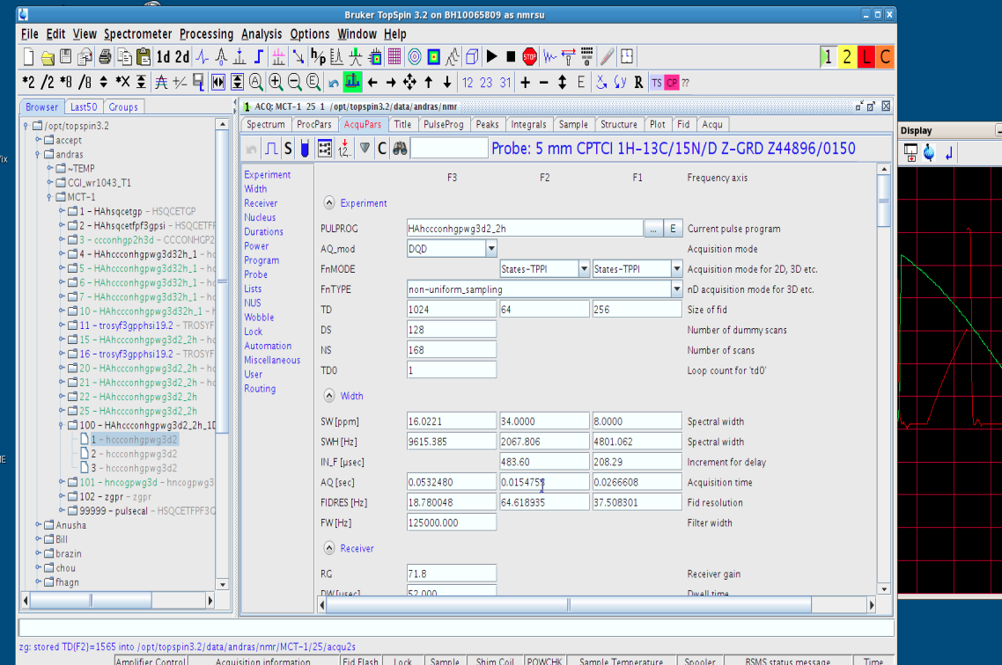
How to set up in Topspin 3.0

Slide 74
Setup on Agilent/Varian
A suit of experiments have NUS implemented.
Setup a linear experiment; record 2D planes and optimize water suppression
Determine how many points you want to sample in each dimension and what percentage of the grid you want to sample.
Make the schedule. Schedule must start with 1.
Copy the schedule to /nmr/biopack/vnmrsys/manual
Click Switch to Non-Linear
Clear schedule and put in your own; then Setup Schedule.
dgnls to take a look, nli2 nli

Slide 75
Setup on Agilent/Varian
A suit of experiments that do NOT have NUS implemented.
Setup a linear experiment; record 2D planes and optimize water suppression
Determine how many points you want to sample in each dimension and what percentage of the grid you want to sample.
Make the schedule. Schedule must start with 0.
Copy the schedule to the directory of the experiment ~biopack/vnmrsys/exp15
Run the script BPNLS_setmanual3dHA(‘schedulename’)
Clear schedule and put in your own; then Setup Schedule.
dgnls to take a look

