Slide 1
Non-uniform sampling and processing
Sven G. Hyberts, Wagner lab
Harvard Medical School
BCMP228 class Dec 7, 2012
sven_hyberts@hms.harvard.edu

Slide 2
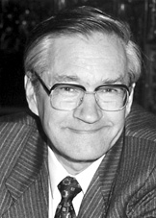
The Nobel Prize in Chemistry December 10, 1991: Richard R. Ernst
A major breakthrough occurred in 1966 when Ernst (together with Weston A. Anderson, USA) discovered that the sensitivity of NMR spectra could be increased dramatically if the slow radiofrequency sweep that the sample was exposed to was replaced by short and intense radiofrequency pulses. The signal was then measured as a function of time after the pulse. The next pulse and signal acquisition were started after a few seconds, and the signals after each pulse were summed in a computer. The NMR signal measured as a function of time is not amenable to a simple interpretation. It is however possible to analyze what resonance frequencies are present in such a signal - and to convert it to an NMR spectrum - by a mathematical operation (Fourier transformation, FT) performed rapidly in the computer.
"Press Release: The 1991 Nobel Prize in Chemistry". Nobelprize.org. 5 Dec 2012 http://www.nobelprize.org/nobel_prizes/chemistry/laureates/1991/press.html

Slide 3
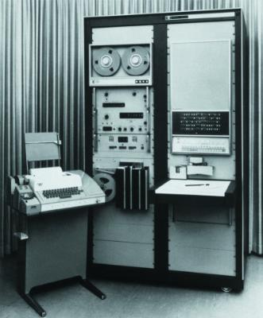
FT-NMR requires:
FT-NMR allows for:
Probing all frequencies in “one shot”
Multidimensional NMR
A computer
The FFT algorithm: Cooley, James W.; Tukey, John W. (1965). "An algorithm for the machine calculation of complex Fourier series". Math. Comput. 19: 297–301

Slide 4
http://www.science-groove.org/Now/Hooray.html

Slide 5
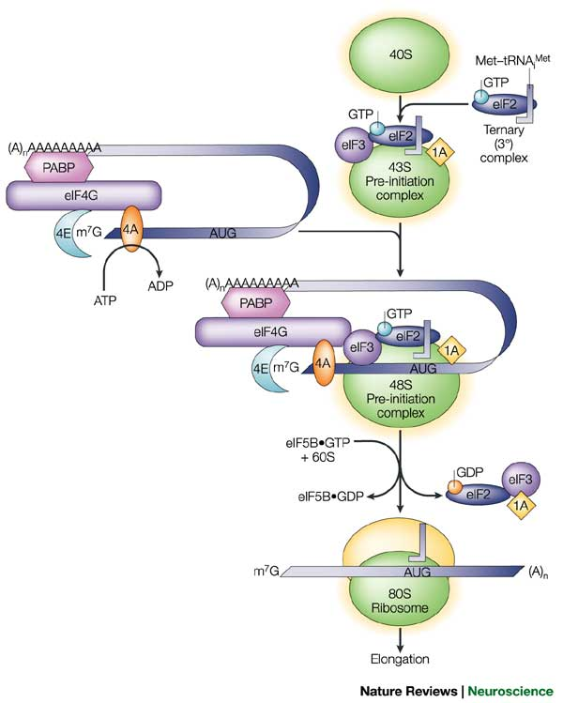
Eukaryotic translation initiation. Interaction eIF4E, mRNA & ribosome.
➔ … cancer therapy
Takeuchi & Wagner, Curr Opin Struct Biol. 16(1), 2006 Luna et al., Cell Reports, 1(6), 2012

Slide 6
Protein-protein interaction in apoptosis. Bcl-2 family, membrane protein VDAC.
➔ … energy control
Hiller et al, Science 321, 2008 Eddy et al, J. Am. Chem. Soc., 134(14), 2012

Slide 7
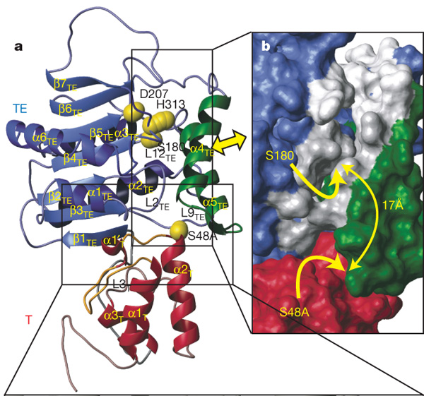
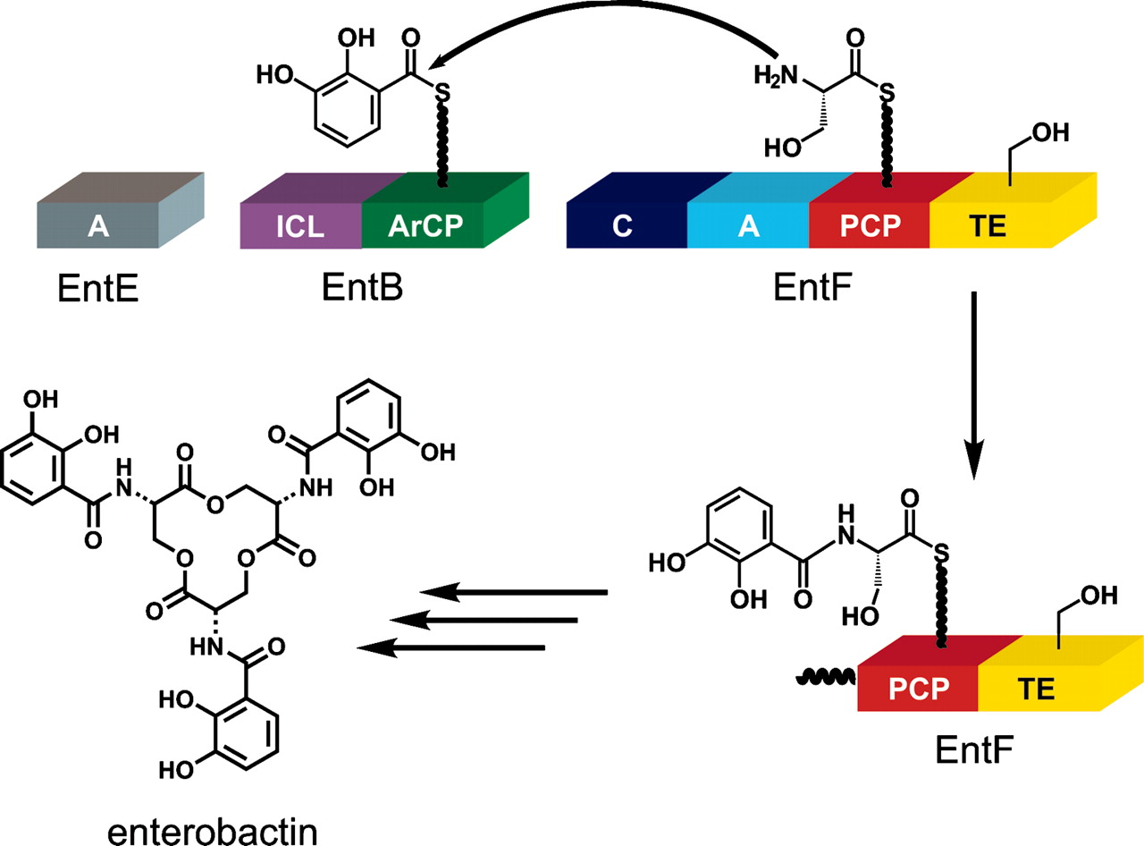
In collaboration: Non-ribosomal peptide synthetizes
➔ … new antibiotics
Frueh et al., Nature 454, 2008

Slide 8
Short: Study of large “NMR” proteins and complexes in biological processes
Large systems brings challenges:
Crowding of NMR spectra
Typically lower concentrations
Longer T₁ relaxation
Shorter T₂ relaxation

Slide 9
Remedy of Spectral Crowding: Higher Magnetic field!
However: Larger frequency width creates smaller dwell time – more data points required for maintained resolution.
Situation not a problem in the direct dimension but becomes time consuming in the indirect dimension(s).
Situation compounded with higher spectral dimensionality, several indirect dimensions.

Slide 10
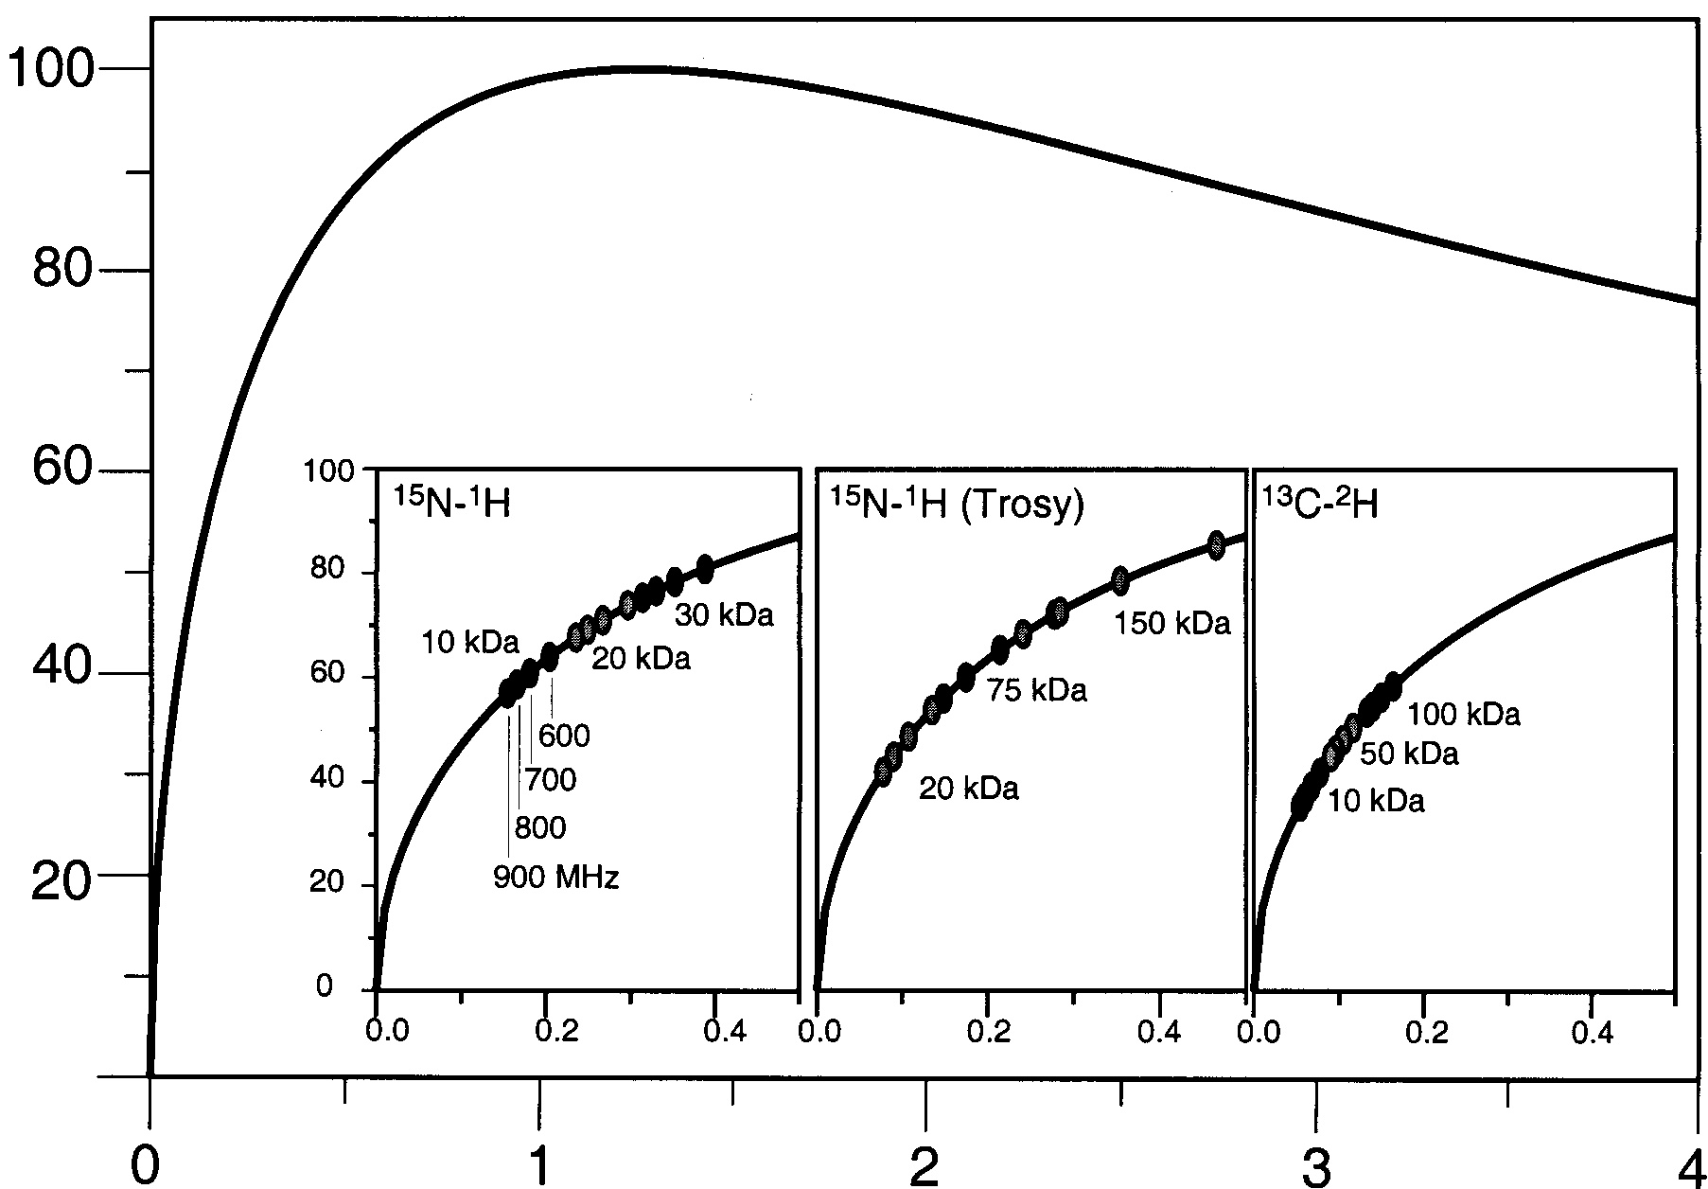
Critical question: Do we use the optimal evolution times t_{max} to maximize resolution and S/N?
Relations between length of evolution time, S/N and resolution are well known
For optimal resolution, τ should be as long as πT₂ - not practical
S/N increases up to τ = τ _{max}~ 0.4 πT₂ but decreases thereafter
S/N
τ_{max} = 1.256 * T₂
τ /T₂
Rovnyak, et al., JBNMR 30(1), 2004

Slide 11
Observation:
We commonly use much shorter evolution times in the indirect dimensions due to constraints on the available measuring time!
S/N
S/N
τ_{max} = 1.256 * T₂
τ /T₂
τ /T₂
Rovnyak, et al., JBNMR 30(1), 2004

Slide 12
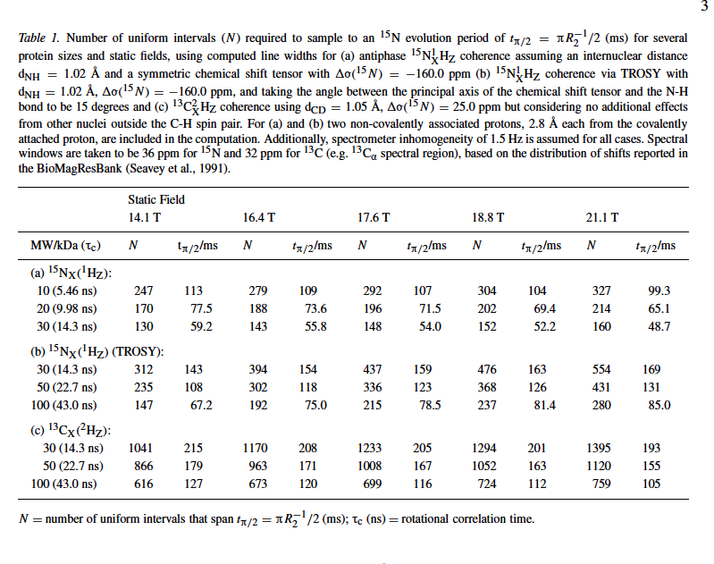
Can be achieved via Non-uniform Sampling (NUS)!
600 MHz
700 MHz
750 MHz
800 MHz
900 MHz
30kD
50kD
30kD
50kD

Slide 13
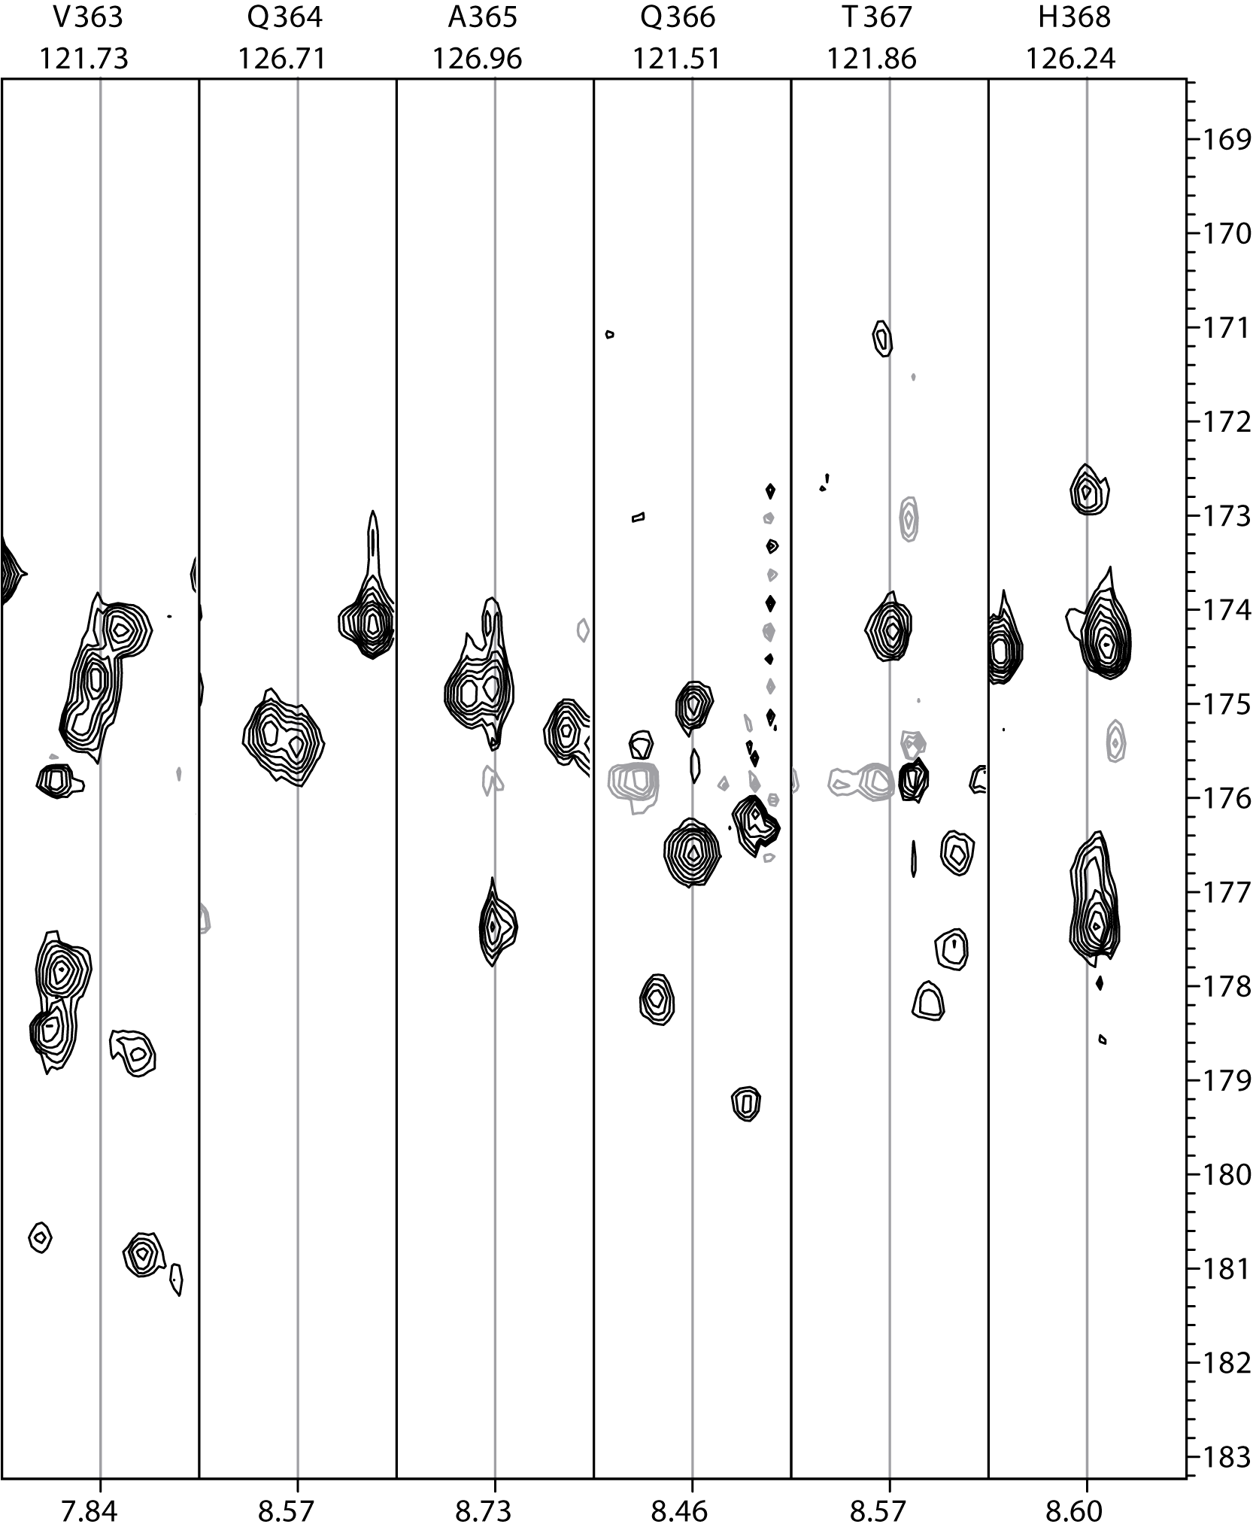
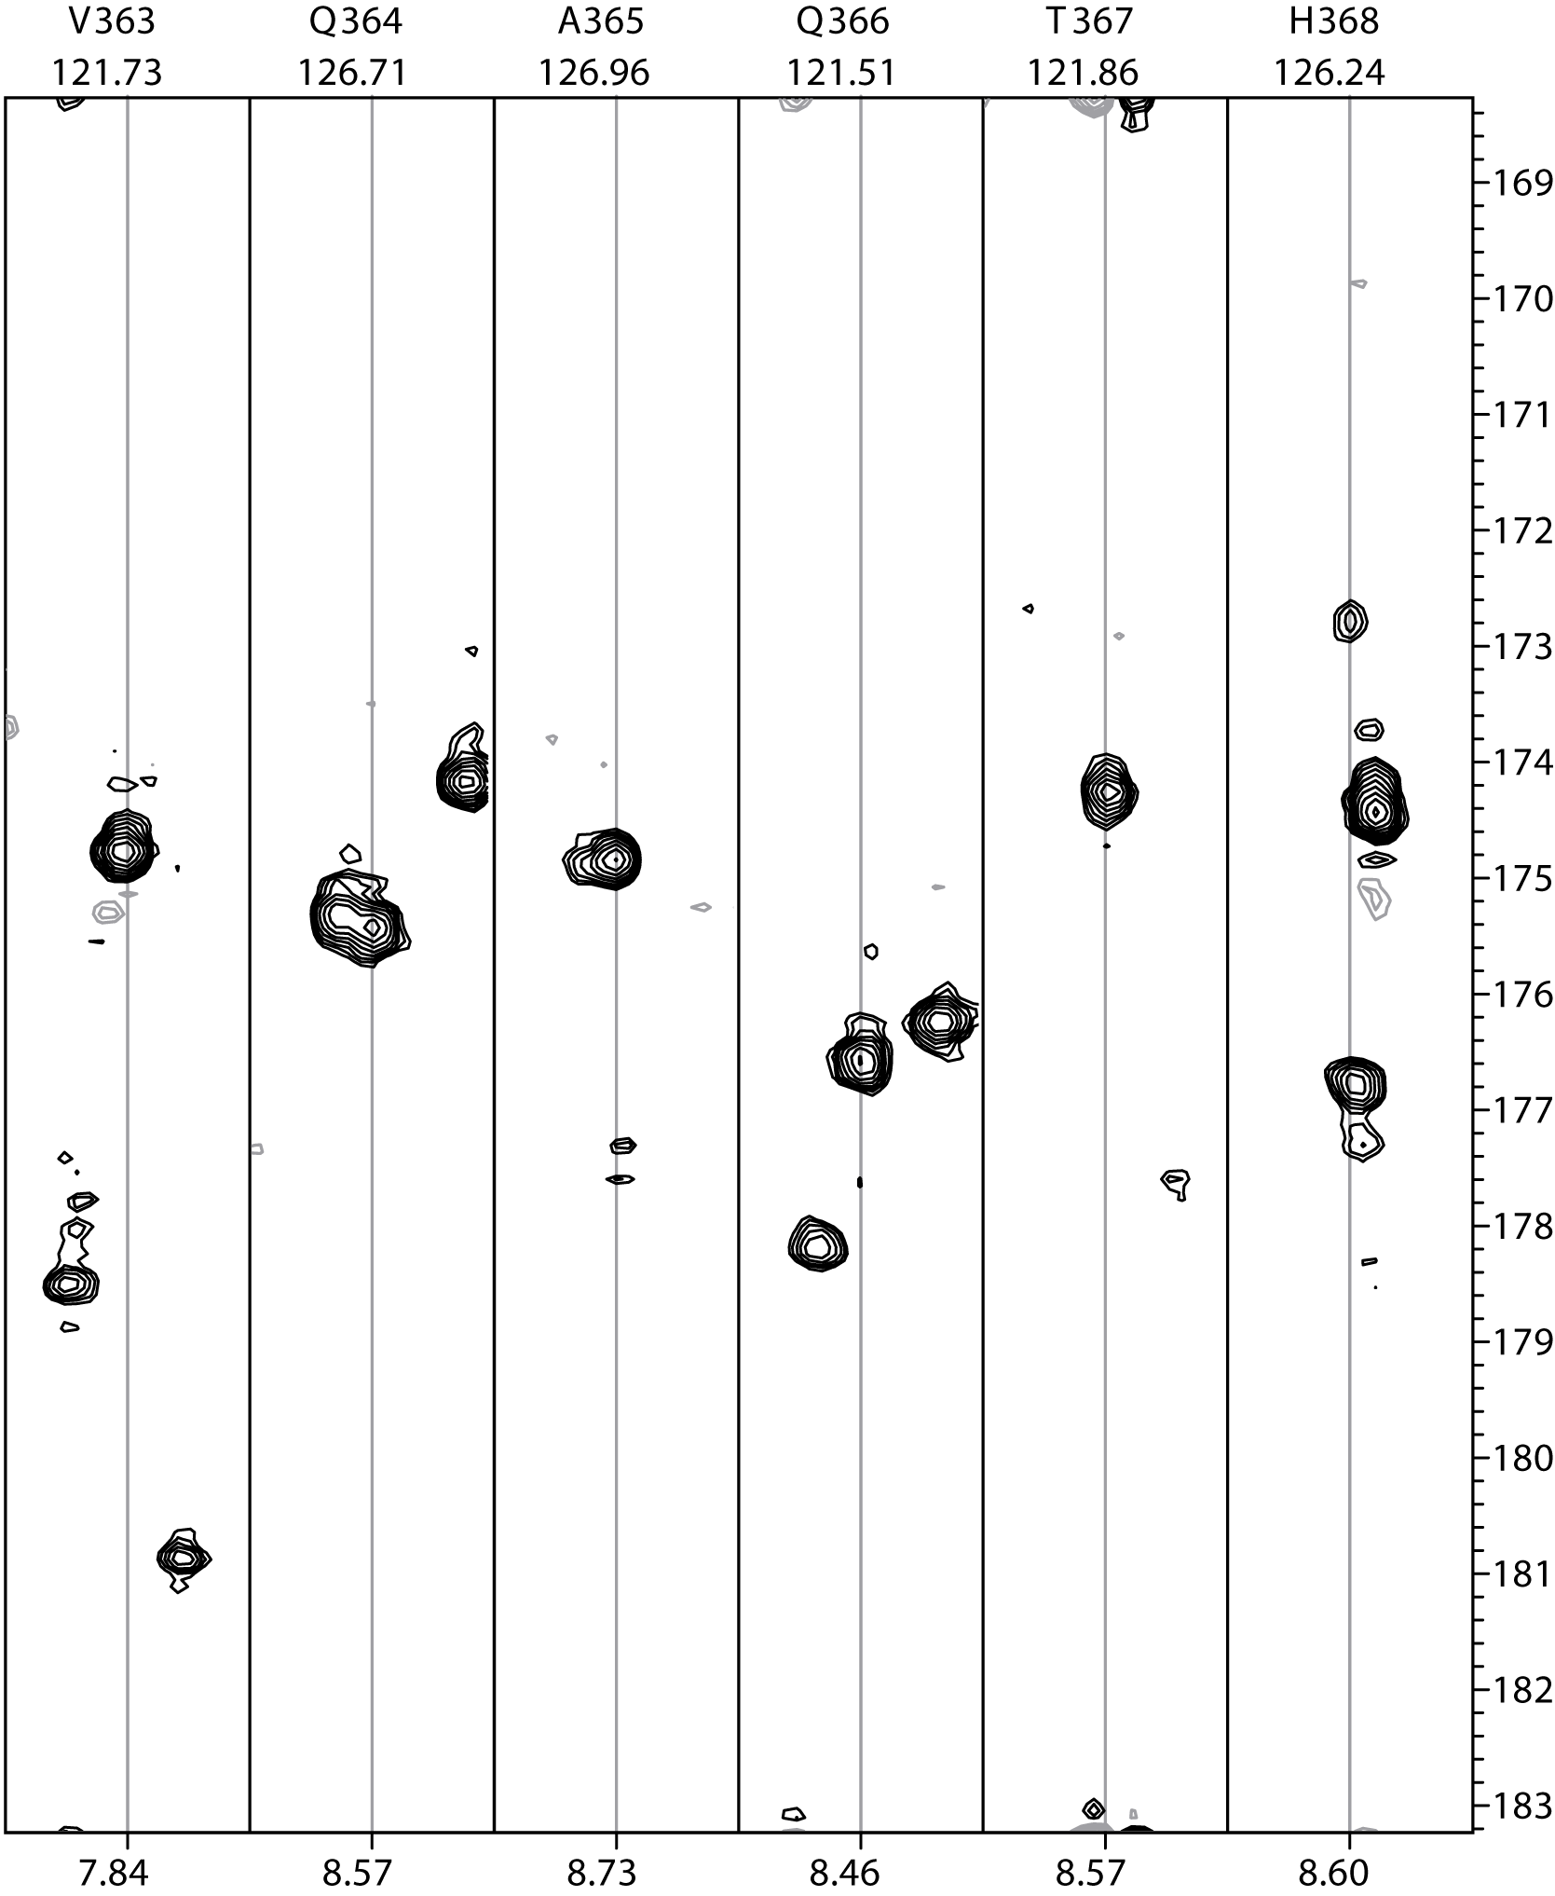
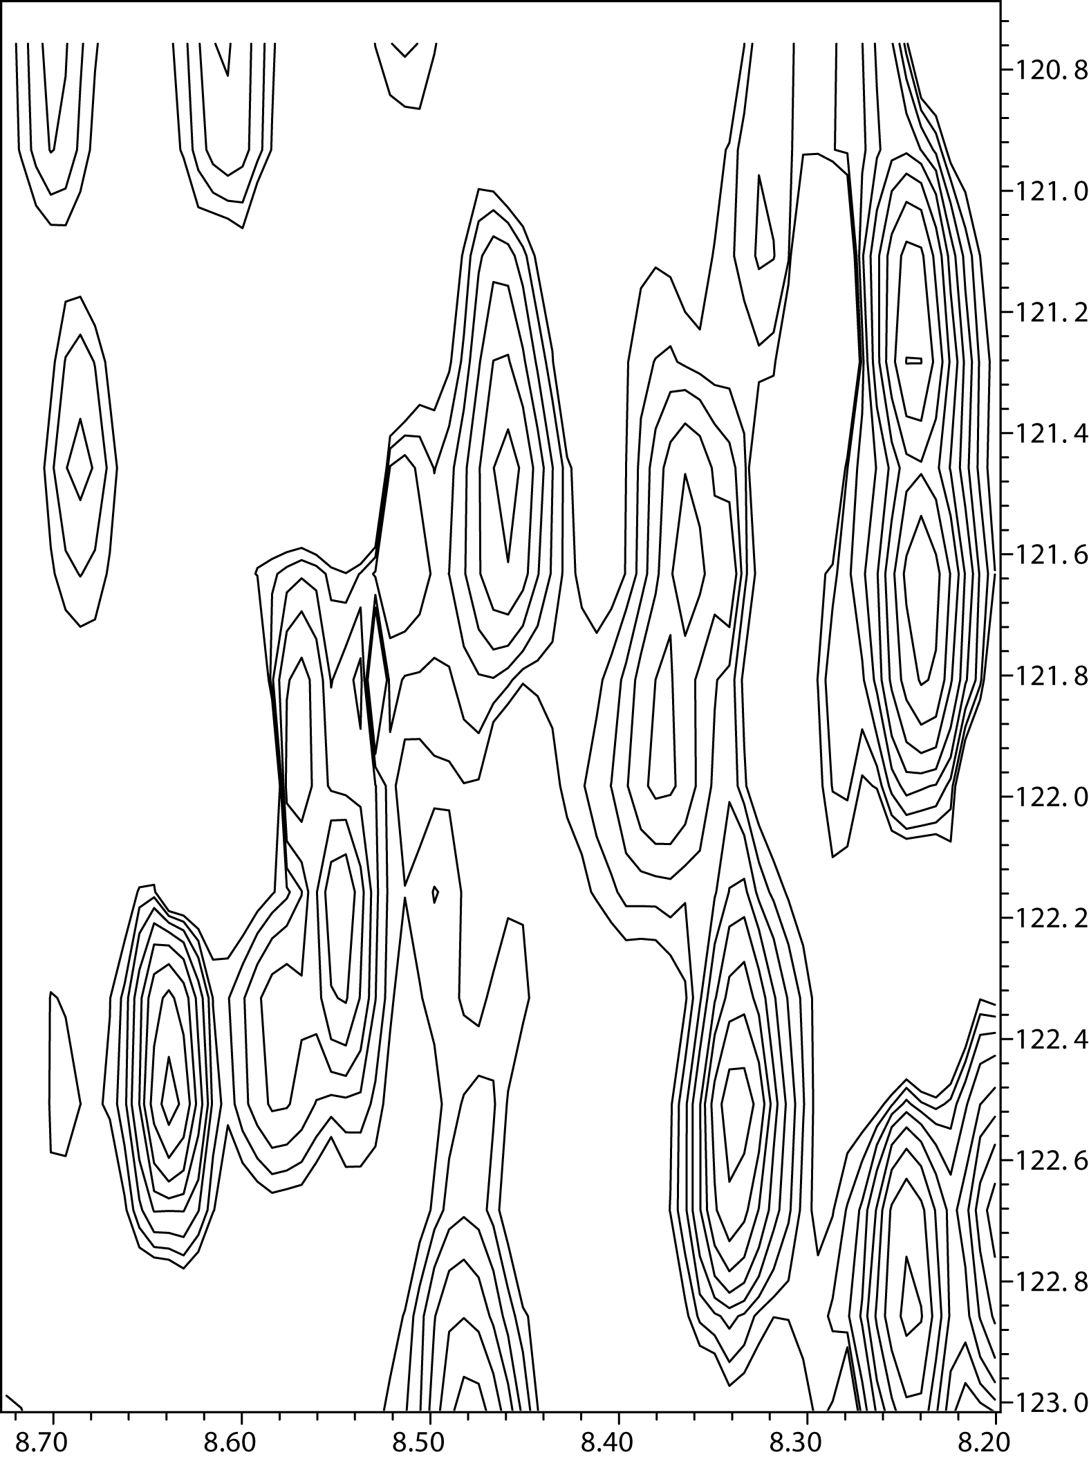
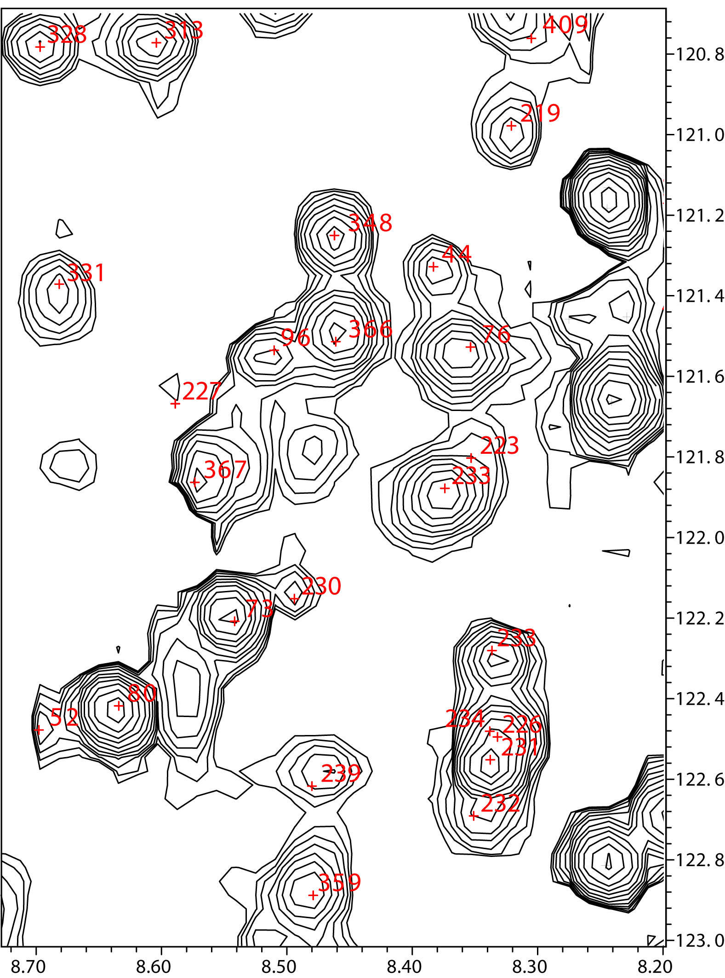
FM reconstructed uniform and non-uniform 3D HNCO of 50 kDa EntF C-domain (900 MHz, 0.3 mM, 6 hours each) τ_{c} ~20-24 ns
D. Frueh
Uniform grid
N:50
C:25
1250 sampling points
Non-uniform grid
N:400
C:100
40,000 grid points
1250 sampled
3% of grid points sampled
Hyberts et al. J. Biomol. NMR 45(3) 2009

Slide 14
PoissonGap GUI Emphasizes the use to 1.2 times T₂
JAVA program to calculate NUS schedules based on Poisson Gap strategy

Slide 15
NUS Reconstruction by FM & IST

Slide 16
Objective
Provide a method that is suitable for quantitative NMR measurements
Implement in an environment that is easily understood

Slide 17
Maximum entropy example
Red blood cell types (USA) | With A Antigen | Without A Antigen
 | 44% | 56%
With B Antigen | AB = ?% | B = ?%
15%
Without B Antigen | A = ?% | 0 = ?%
85%
Consider following simple case: assume AB = x % then B = (15-x)% A = (44-x)% and 0 = (41+x)%
Maximize S = – xlnx – (.15-x)ln(.15-x) – (.44-x)ln(.44-x) – (.41+x)ln(.41+x)

Slide 18
S = – xlnx – (.15-x)ln(.15-x) – (.44-x)ln(.44-x) – (.41+x)ln(.41+x)

Slide 19
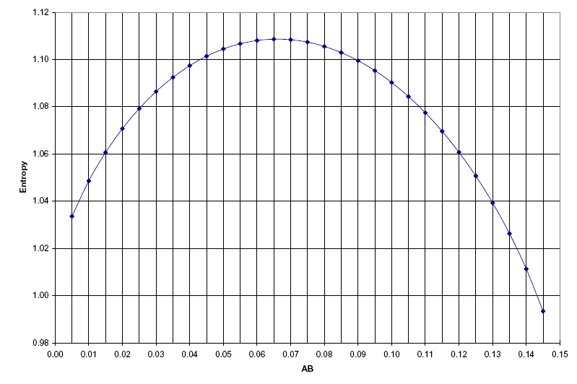
Blood type example
Red blood cell types (USA) | With A Antigen | Without A Antigen
 | 44% | 56%
With B Antigen | AB = 4% | B = 11%
15%
Without B Antigen | A = 40% | 0 = 45%
85%
Red blood cell types (max entorpy) | With A Antigen | Without A Antigen
 | 44% | 56%
With B Antigen | AB = 6.6% | B = 8.4%
15%
Without B Antigen | A = 37.4% | 0 = 47.6%
85%

Slide 20
MaxEnt NMR reconstruction

Slide 21
Maxent not suitable linear – depends on the parameter λ
Hoch & Stern, NMR Data Processing (1996)

Slide 22
FM reconstruction
Hyberts et al. J. Am. Chem. Soc., 129(16) 2007

Slide 23
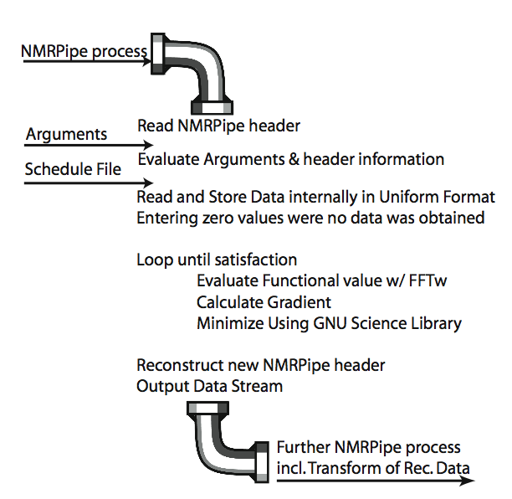

Slide 24
Insights reg. FM (Forward Maximum Entropy)
Has no λ, hence linear!
Leave the data in time domain, normal processing may follow.
Typically algorithmic slower than traditional MaxEnt.

Slide 25
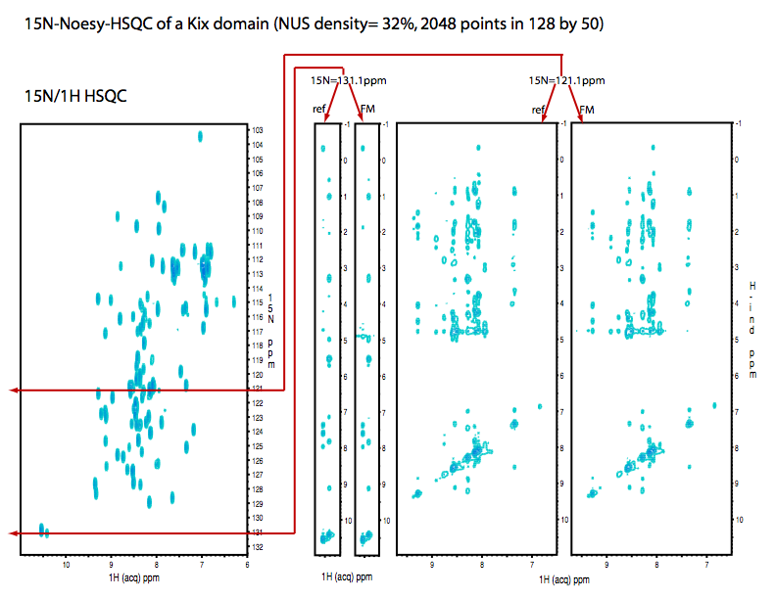
FM provide great fidelity

Slide 26
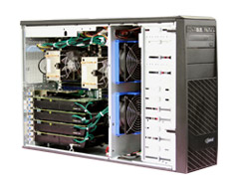
Quandary
How long does it take to transform a 4D spectrum?
For a 10% sampled 32(x2)x32(x2)x16(x2) 3 dimensions out of a 4D; ~118,000 different 3D spectra are required for the gradient!
Assume 10ms/each -> 20 min.
Each minimization step, each point in direct dim.
200 steps, 200 points -> 550 days
nVidia GPU processors

Slide 27
Multiple “Entropies”

Slide 28
Introducing l₁-norm minimization
“Linear”!

Slide 29
IST (minimum l₁ norm) is based in the Compressed Sensing theory:
Shannon was a pessimist and his sampling rule always considered the worst possible case for any bandlimited data.
CS: sparse signals can be recovered from a small number of non-adaptive linear measurements”
This idea integrates the sensing, compression, and processing of data and is based on:
• The sparsity of the data • The incoherence of the representation and measurement bases

Slide 30
IST (minimum l₁ norm) is based in the Compressed Sensing theory:
Theorem
Given representation and measurement bases Ψ and Φ with known coherence and f s-sparse in the Ψ basis and C a positive constant, select m basis vectors uniformly at random from Φ with
m ≥ C · μ2(Φ,Ψ) · s · log(n) and by minimizing according to l₁ the signal can be reconstructed with overwhelming probability.
No need to sample more!!!

Slide 31
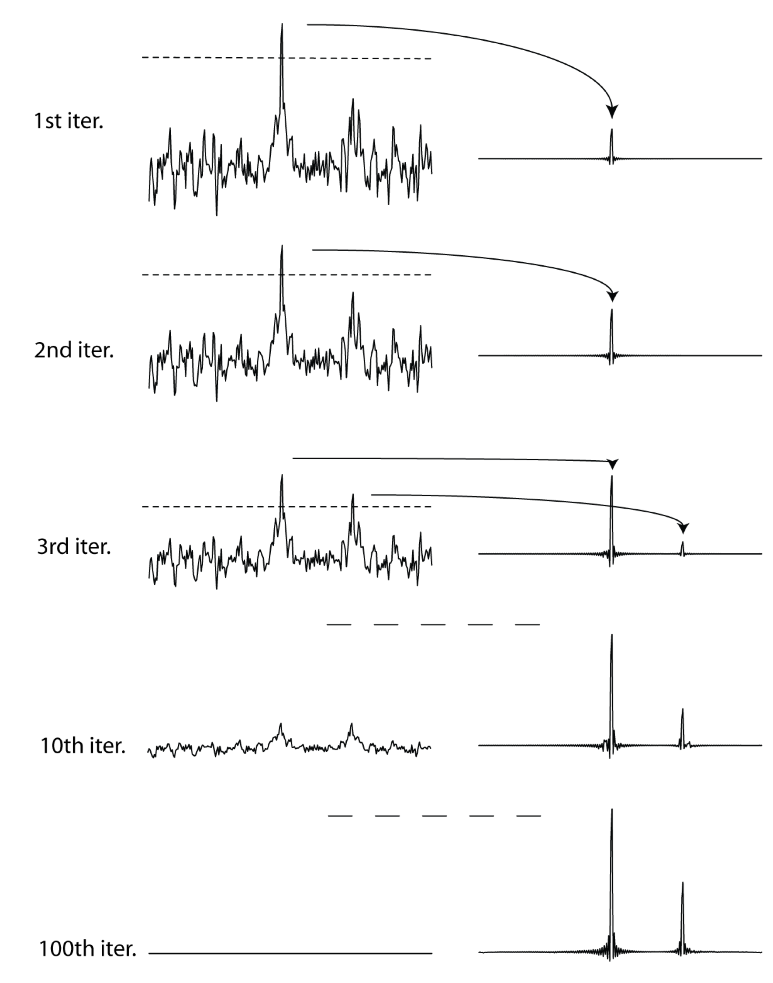
Iterative Soft Threshold (hmsIST) outlined
NUS synthetic two line spectrum
FFT produces spectrum with many artifacts (point spread function, PSF)
Copy top 2% of spectrum and store in different location
FFT⁻¹ and zero skipped time domain data points - subtract
FFT and iterate
After a sufficient number of iteration all PSF artifacts are eliminated
Very fast procedure
Hyberts et al. J. Biomol. NMR 52(4) 2012

Slide 32
Different implementations of IST have been described previously
Papoulis, IEEE Trans. Circuits Syst. 1975, 22, 735.
As a general method for data processing
D. L. Donoho, “Compressed sensing,” IEEE Transactions on Information
Theory, vol. 52, no. 4, pp. 1289–1306, 2006.
I. Drori, EURASIP Journal on Advances in Signal Processing
Volume 2007, Article ID 20248
using a wavelet representation
Stern, D.L. Donoho, J.C. Hoch, JMR 188, 295, 2007
IST to extend truncated FIDs, instead of linear prediction Shows IST is l₁-norm minimization
K. Kazimierczuk, V. Yu. Orekhov, Angew Chem. Int Ed. 50 (24) 5556. 2011 processing of 2D HSQC and 2D NOESY spectra

Slide 33
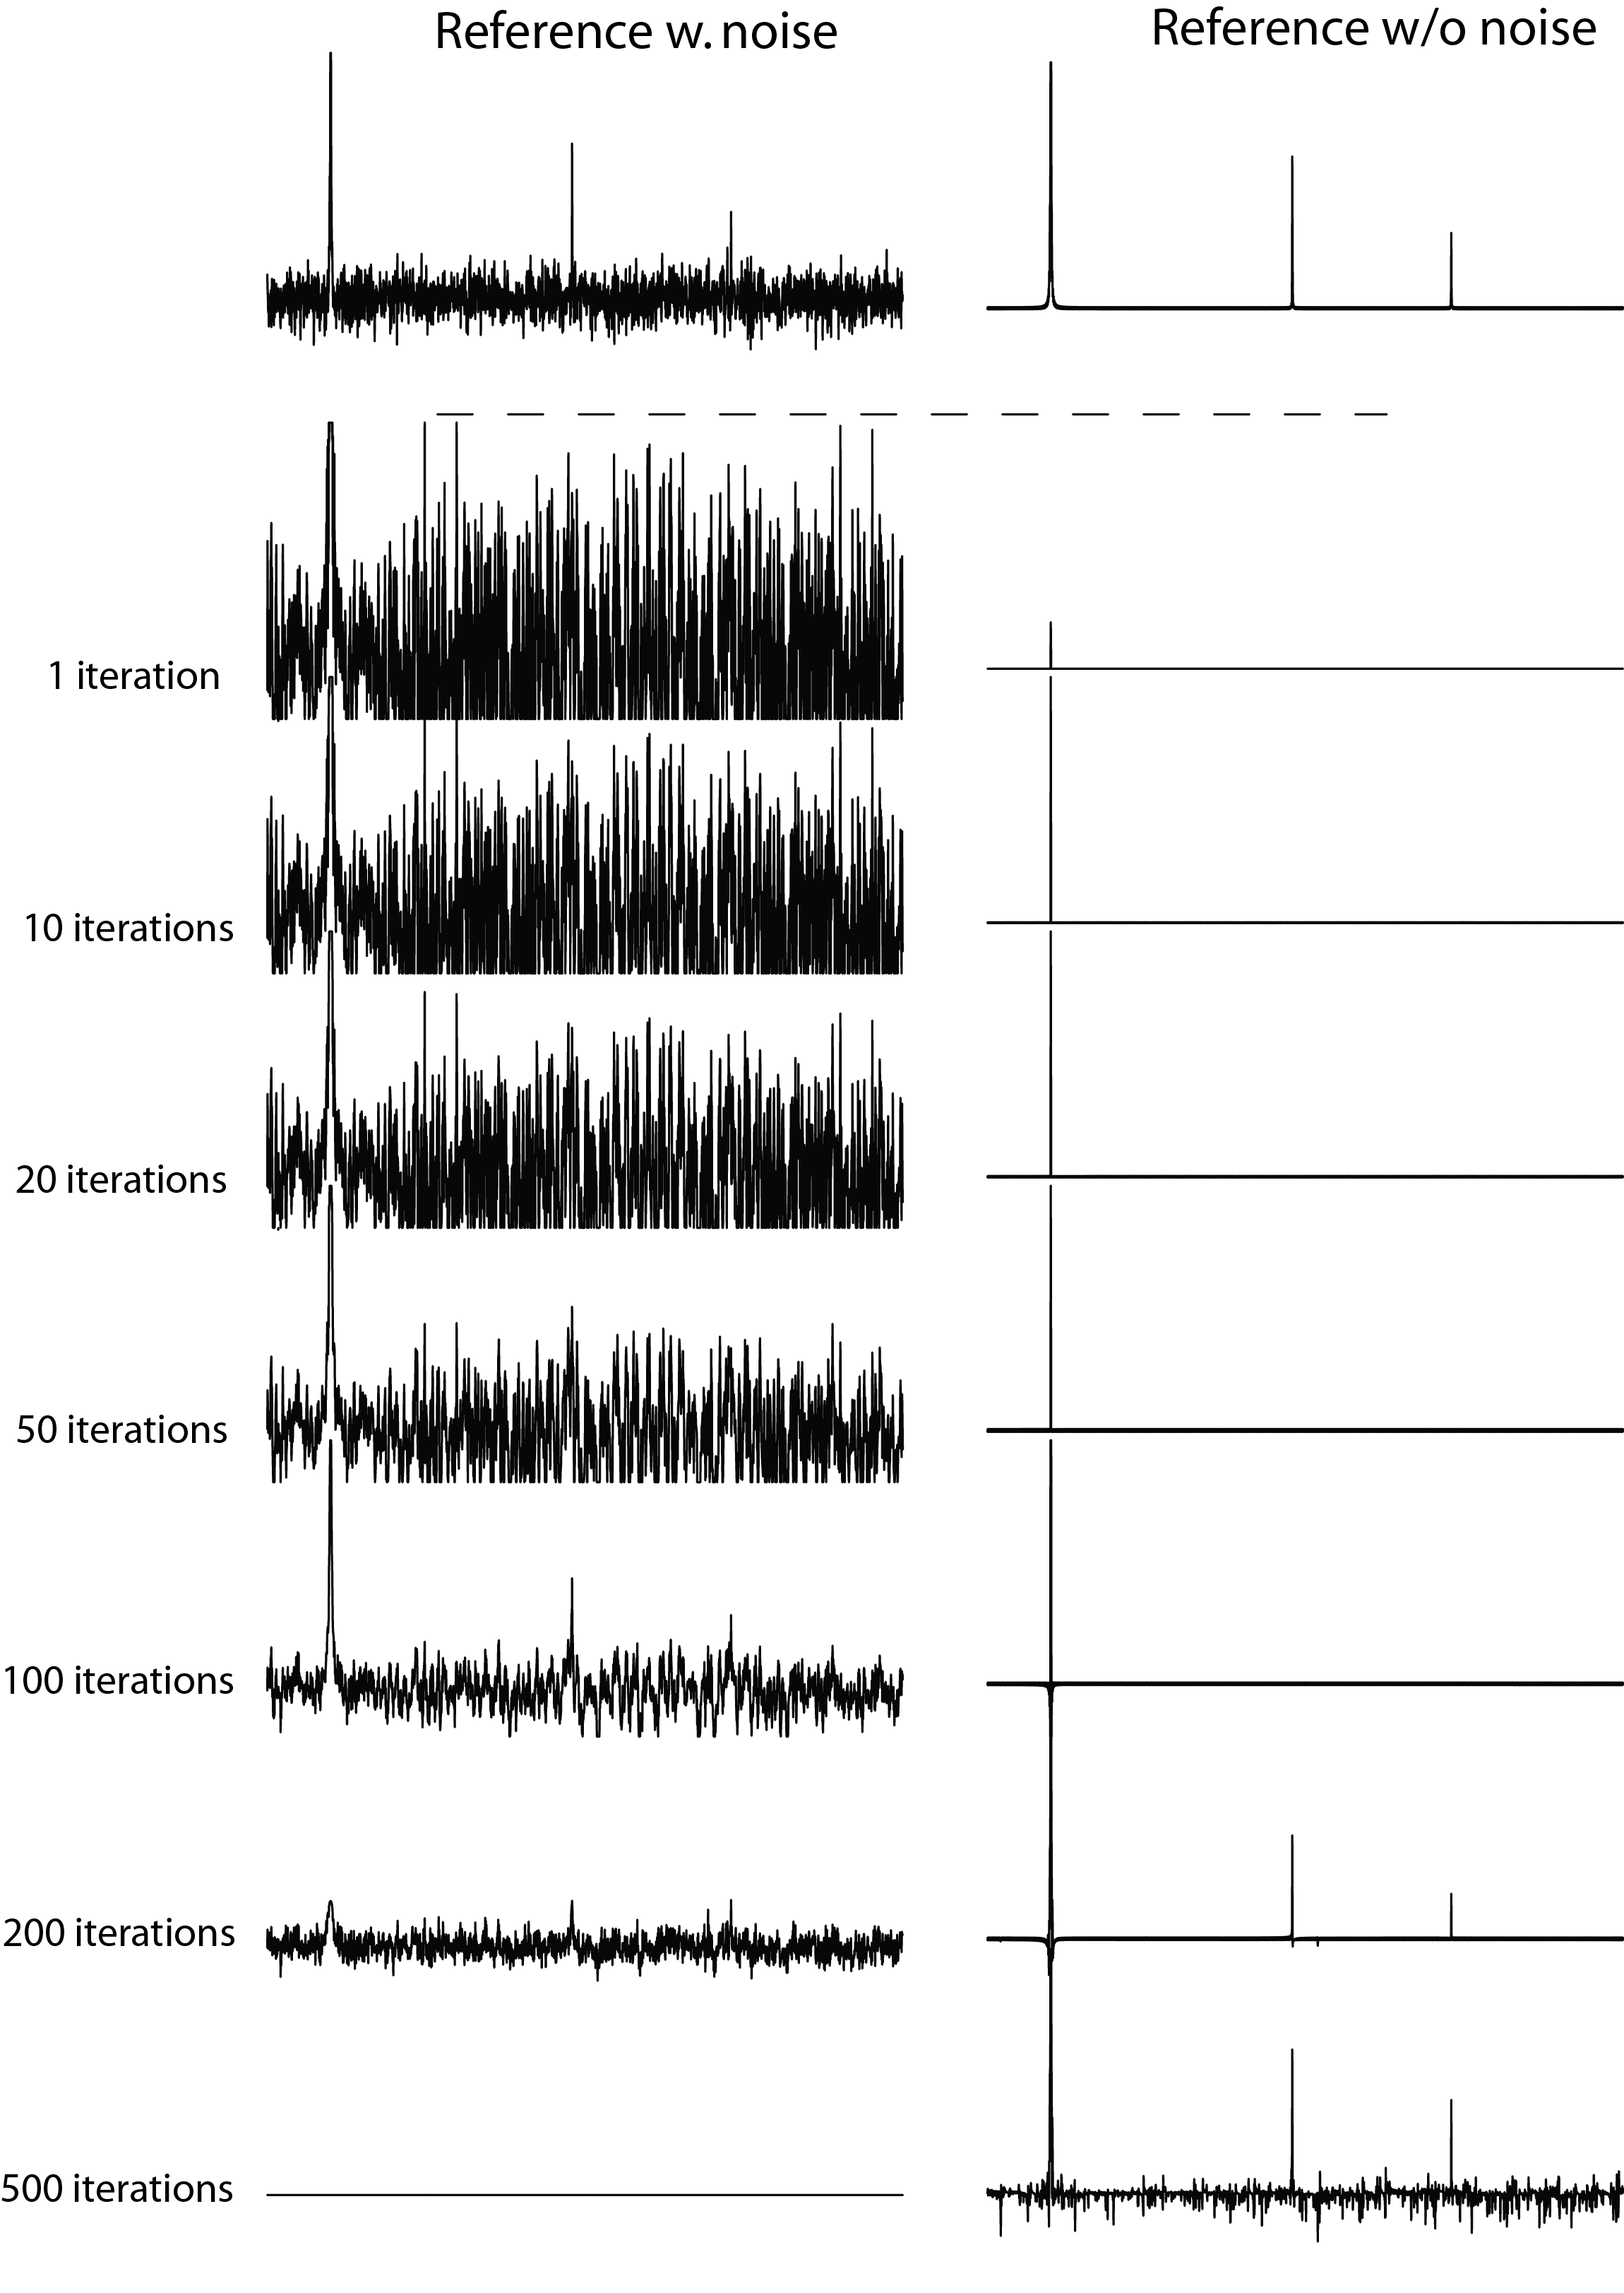
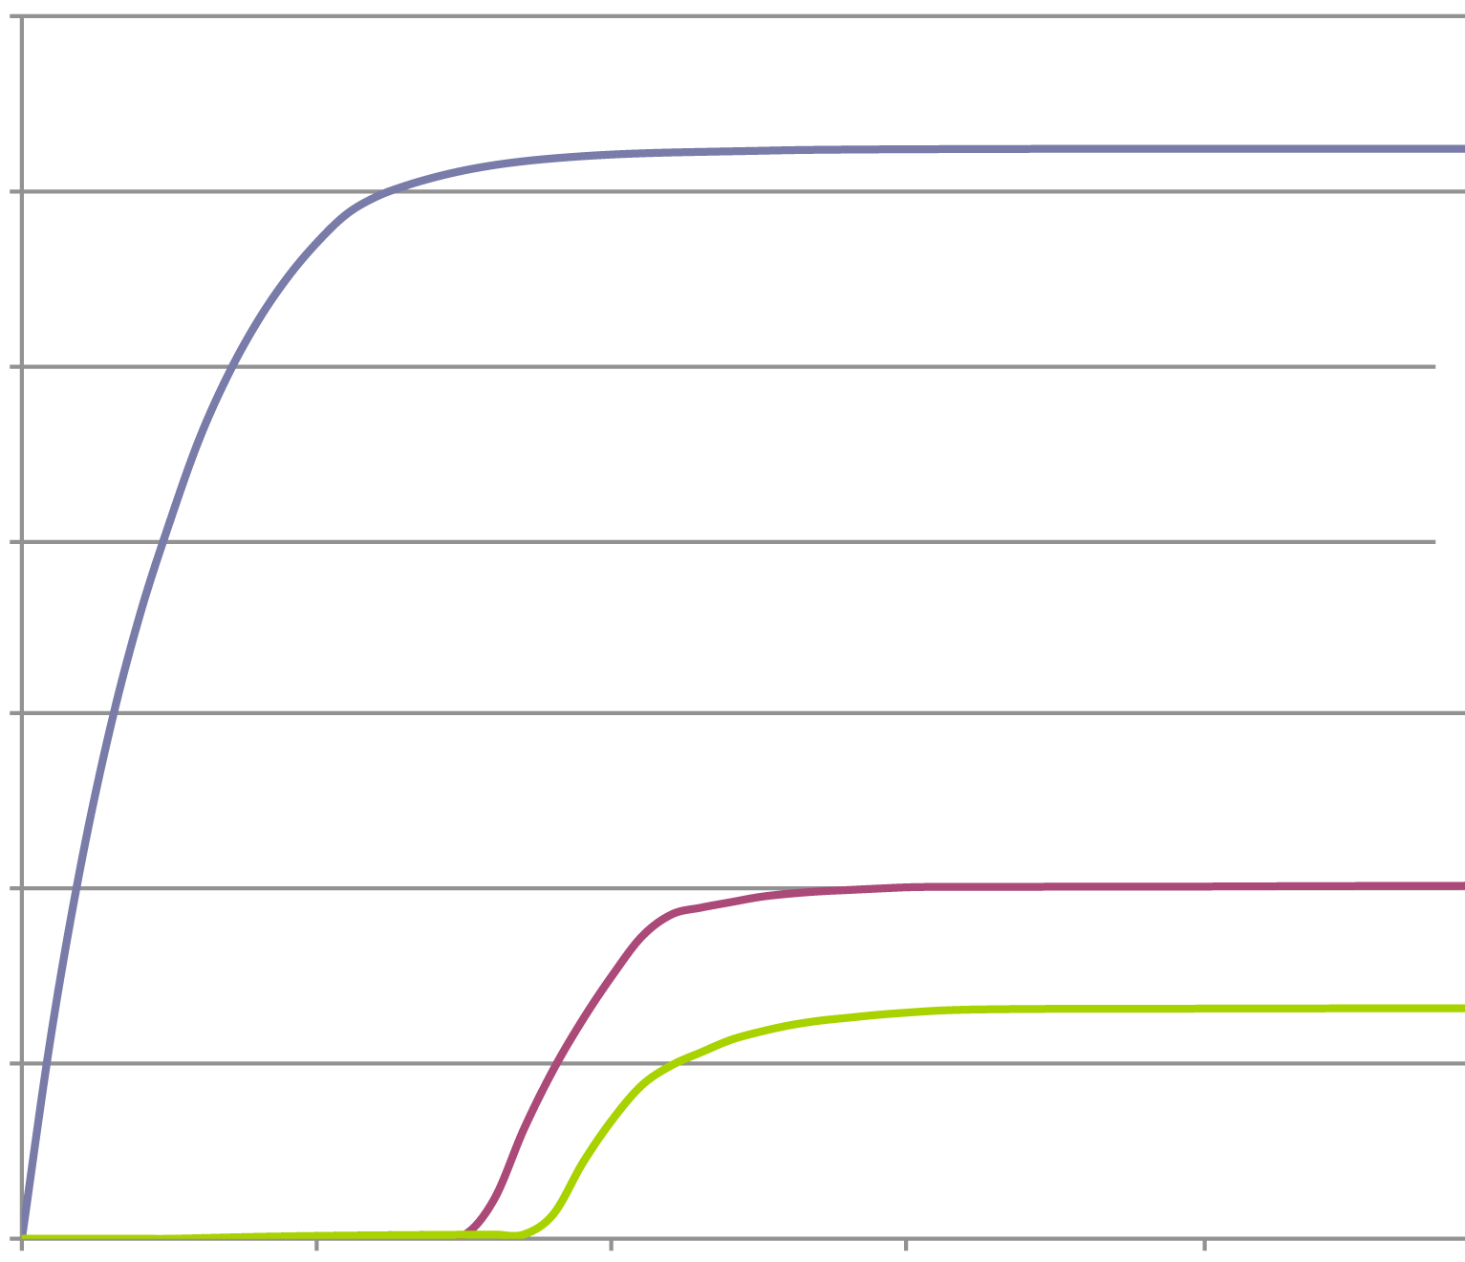
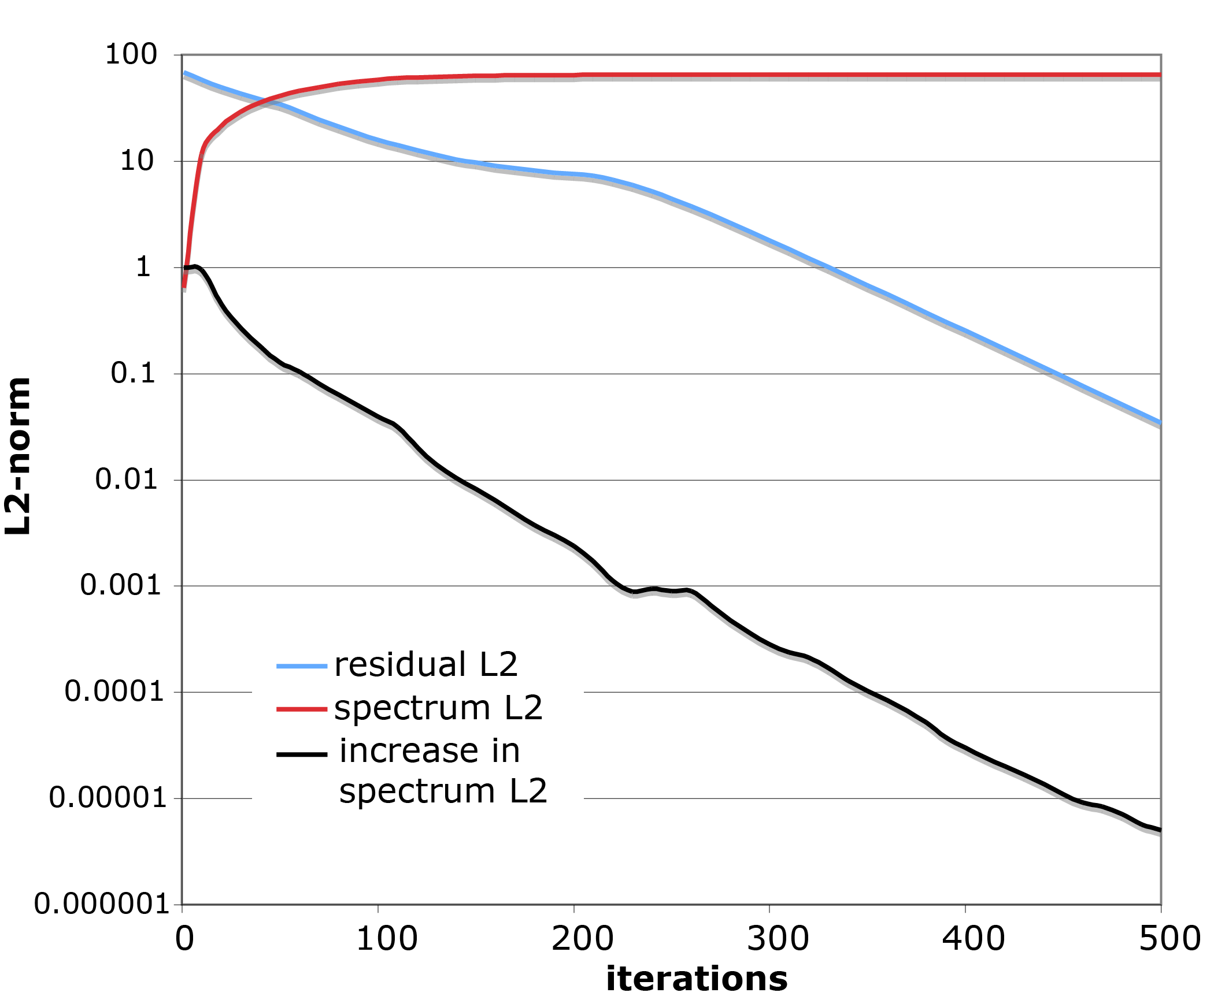
hmsIST provide high dynamic range response, stop criterion
A
B
50
50/10
2
6.0E+6
1
5.0E+6
4.0E+6
3.0E+6
2.0E+6
2
1
1.0E+6
0.0E+6
0 100 200 300 400
C
Spectrum L₂
Residual L₂
Increase in spectrum L₂
Notes:
256 of 1,024 data points were selected using the Poisson-Gap sampling method
threshold of 98%.

Slide 34
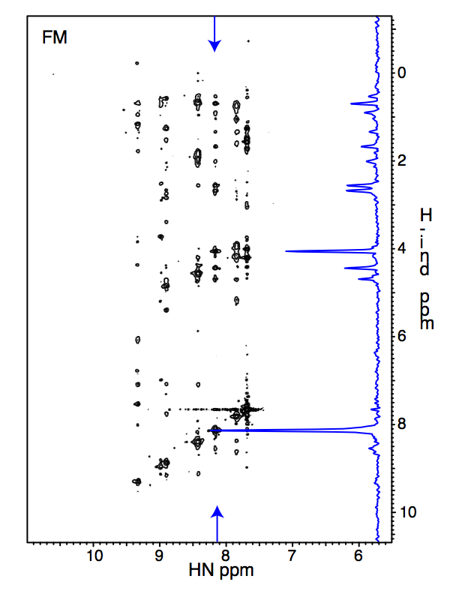
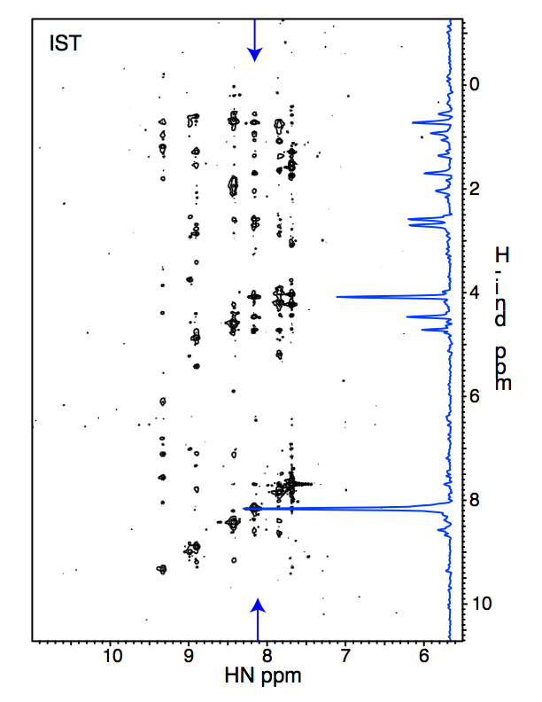
IST faster than FM reconstruction of NUS 3D NOESY
6% of 400x100 (HxN) Nyquist grid (2,400 of 40,000)
FM
IST
H. Anthanari
H_{indirect} (ppm)
1.5 days on CUDA computer with 4 Nvidia GPU cards
3 min on 128 CPU cluster

Slide 35
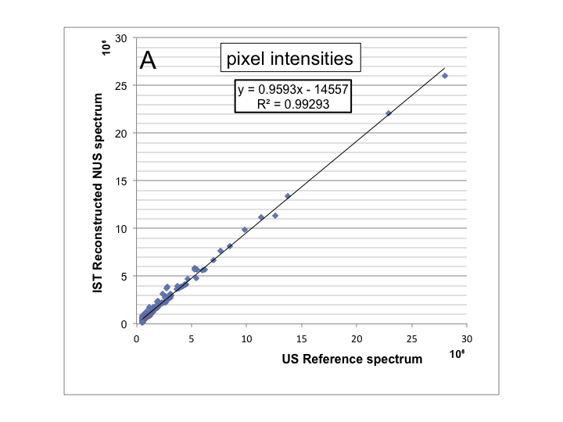
IST is practically linear

Slide 36
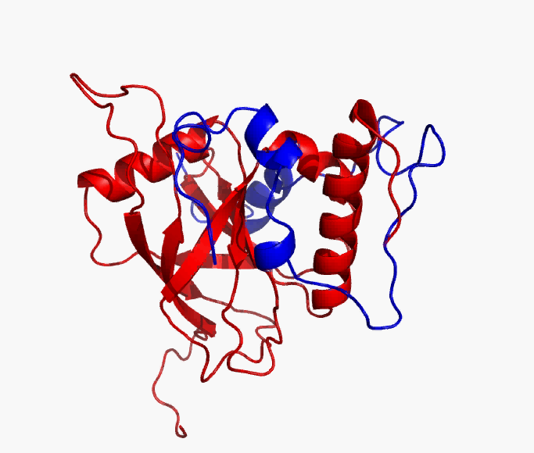
NUS 4D high-resolution methyl-methyl CH-NOESY-CH allowed structure determination of a dynamic transcriptional activator/co-activator complex (MED25/VP16)
Relied heavily on NUS methyl NOESYs
Milbradt et al. Nat. Struct. Mol. Biol. 18(4) 2011

Slide 37
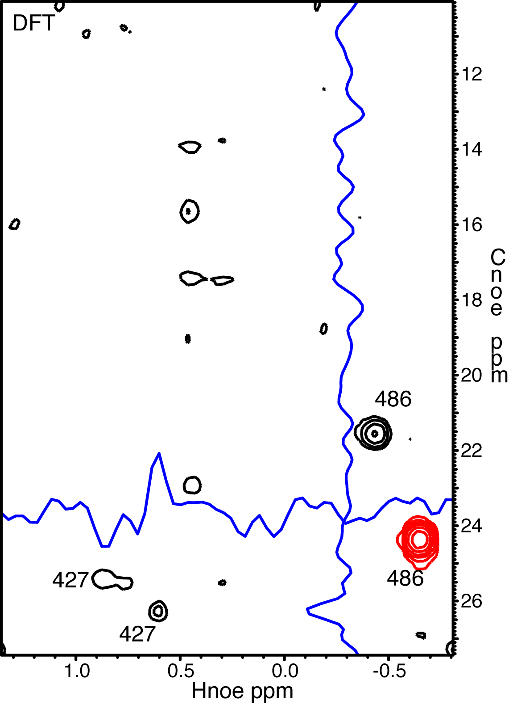
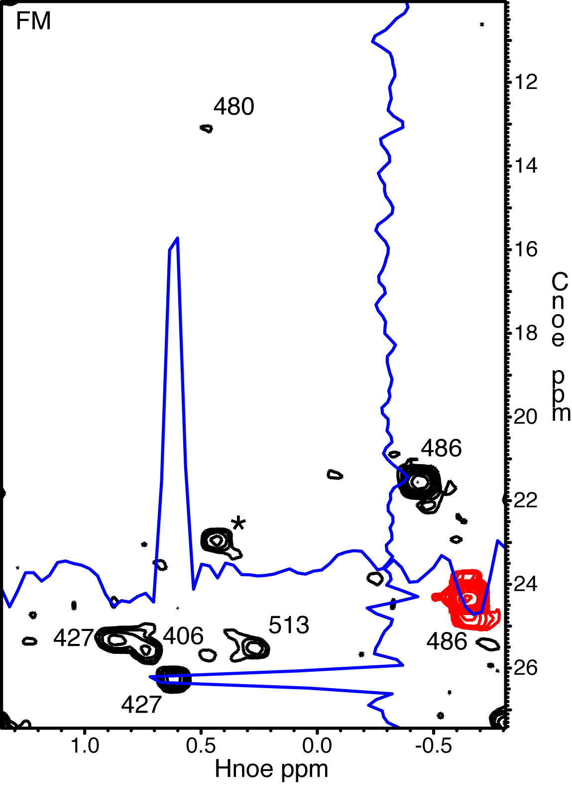
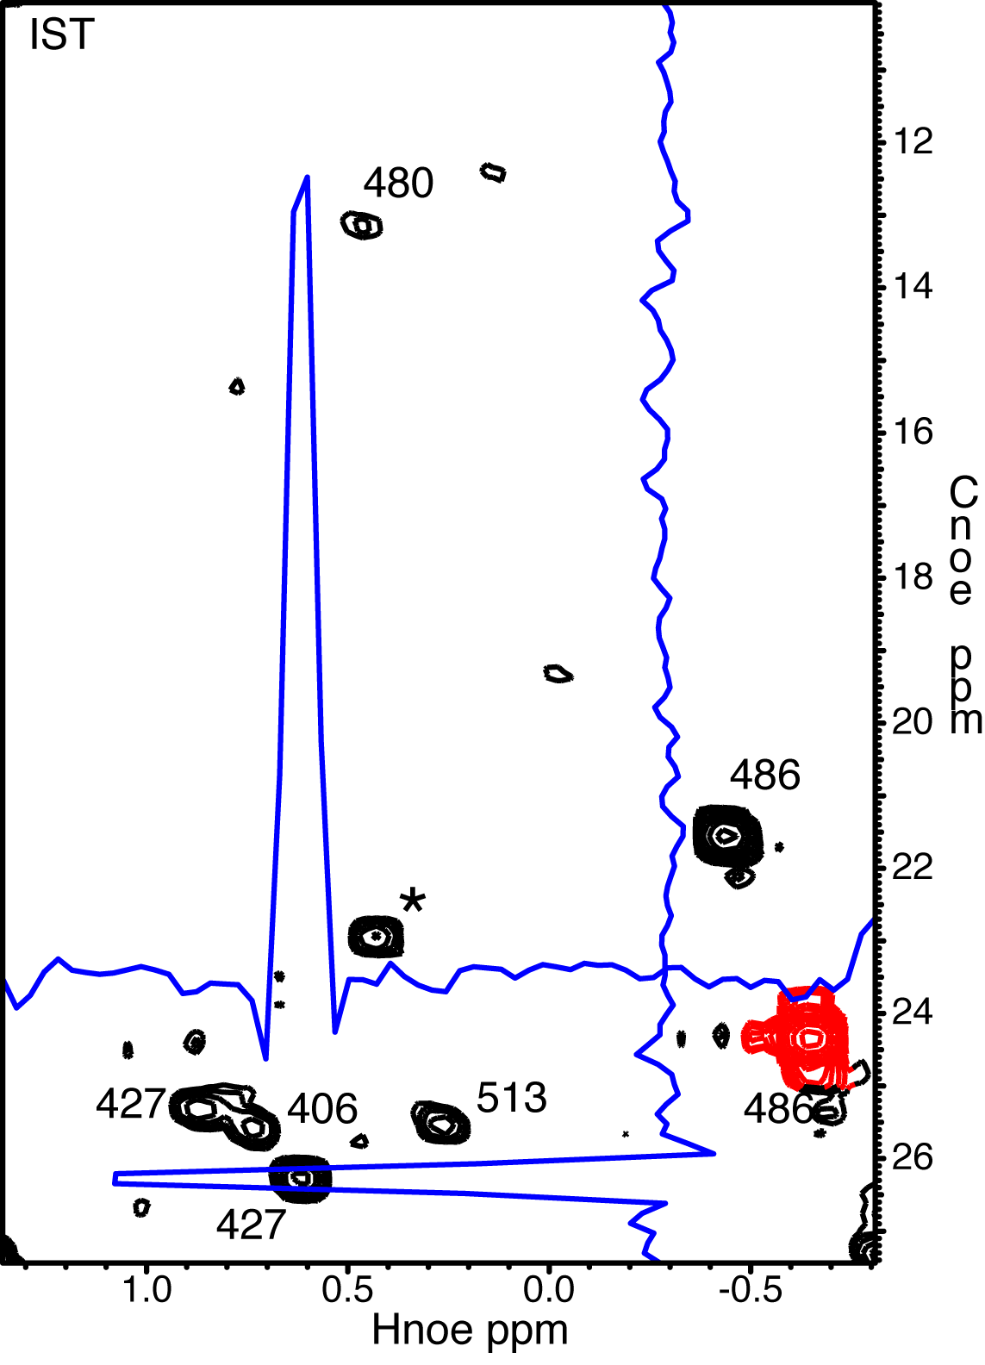
DFT/FM/IST reconstruction of NUS 4D HC-HC NOESY - 15% sampled
(MED25/VP16)
DFT
FM
IST
A. Milbradt
1 cube 13 hrs
1 Nvidia C2050 GPU card
339 cubes 1.5 hrs
128 cpu cluster

Slide 38
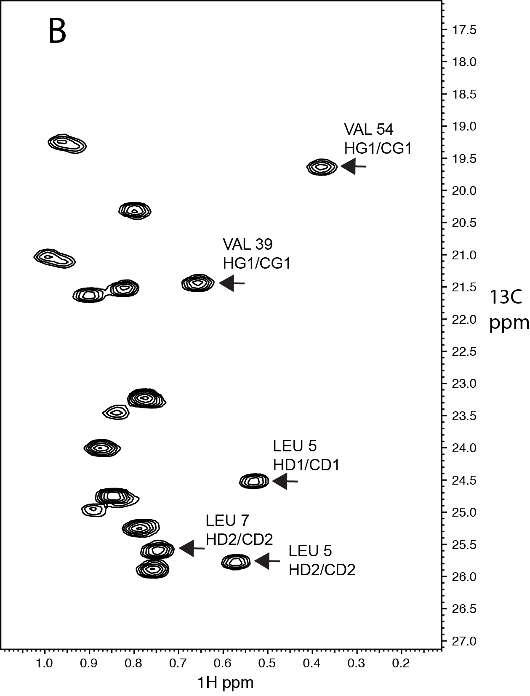
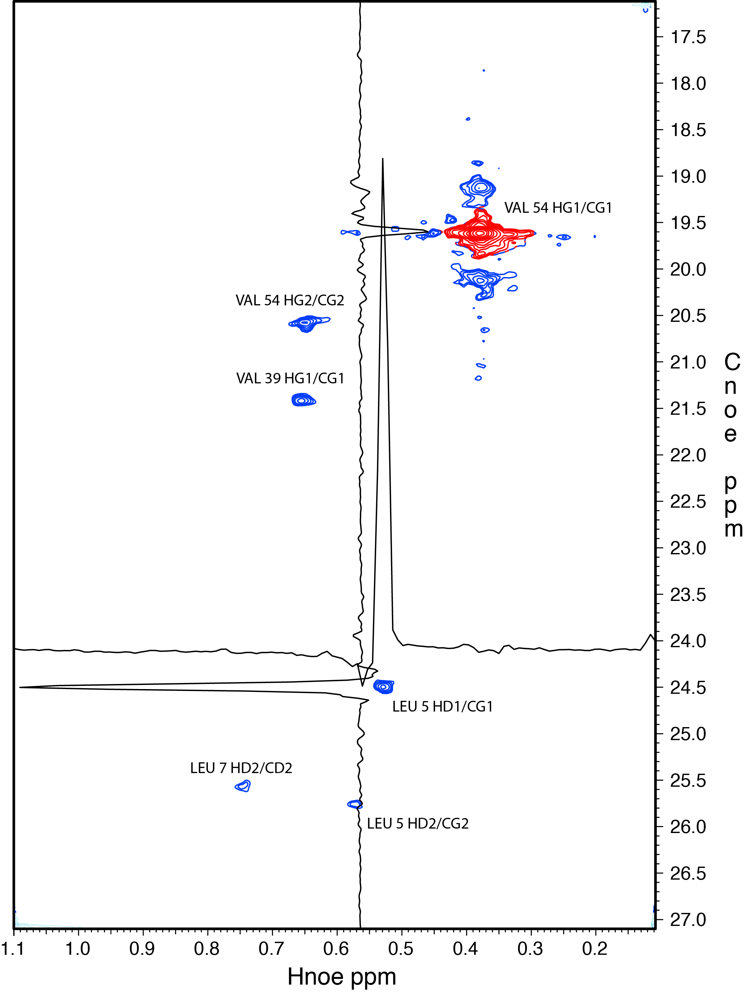
IST reconstruction of NUS 4D HC-HC NOESY - 0.8% sampled - GB1
B
1H ppm
1H ppm
reconstructed with istHMS ~ 1 day on 128 cpus
Notes:
10,906 of the 1,350,000 indirect data points (complex) (0.8%) were measured with a Poisson-Gap sampling schedule.
60 x 150 x 150 proton dimension 500.1 Hz;
carbon dimensions 1,257.6 Hz

Slide 39
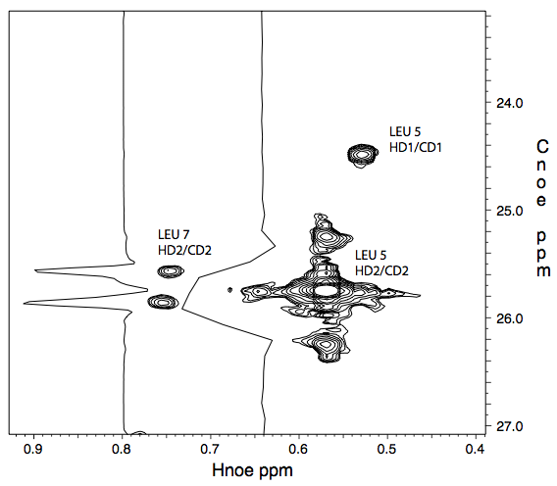
IST reconstruction of NUS 4D HC-HC NOESY - 0.8% sampled - GB1
1H ppm
reconstructed with istHMS ~ 1 day on 128 cpus
Notes:
10,906 of the 1,350,000 indirect data points (complex) (0.8%) were measured with a Poisson-Gap sampling schedule.
60 x 150 x 150 proton dimension 500.1 Hz;
carbon dimensions 1,257.6 Hz

Slide 40
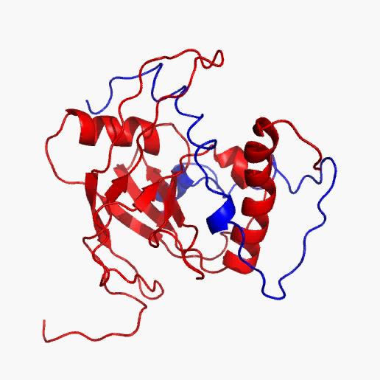
14.5% NUS methyl-methyl NOESY 1mM Med25/VP16 complex (28 kDa)
750MHz 4D 13C-dispersed NOESY (150 ms mixing). 14.5% (17,150 of 118,272 complex points). Total measuring time 5 days. IST reconstruction was achieved in 1.5 hrs on a cluster of 128 cpus.
0.8% NUS methyl-methyl NOESY 0.9 mM GB1 (10 kDa)
Would take 500 days to measure uniformly
500 MHz 4D 13C-dispersed NOESY (120 ms mixing). 0.8% (10,906 of 1,350,000 complex points). Total measuring time 5 days. IST reconstruction was achieved in one day on a cluster of 128 cpus.

Slide 41
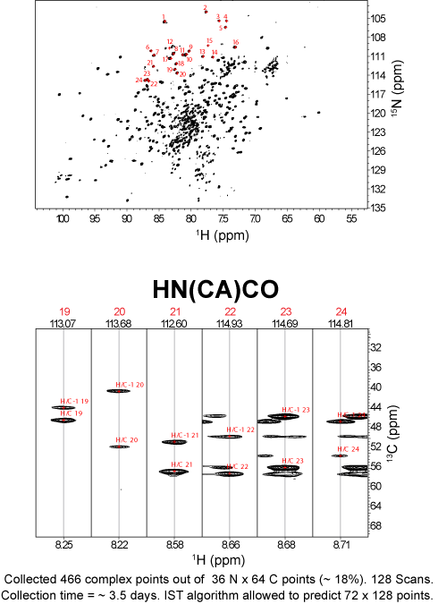
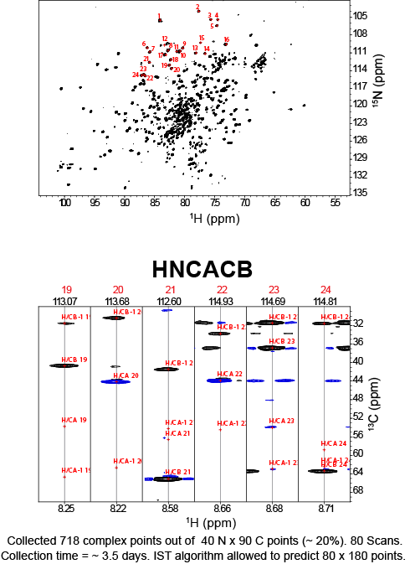
'A' domain (Adenylation Domain) of EntF.
505 amino acids long, 55 kDa
300 uM. 800 MHz.
S. Robson
Notes:
EntF is an enterobactin synthetase (enterobactin is asiderophore that helps E. coli acquire iron from hosts).

Slide 42
Sampling Strategy (Poisson Gap)

Slide 44
Some of these sampling schedules are well known
Sampling every fourth data point – brings folding
All 256 data points contiguously at the beginning, – would be practical
Intuitively: some schedules are better (more “random”) than others.

Slide 45
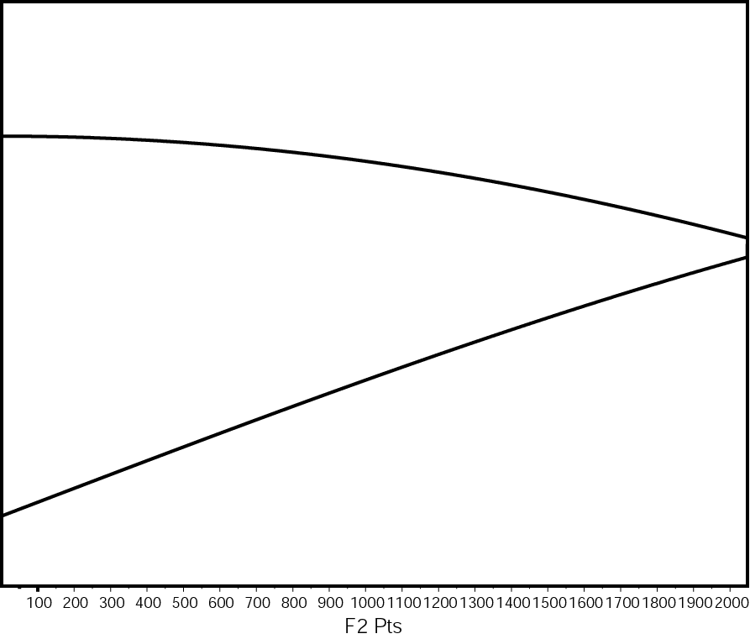
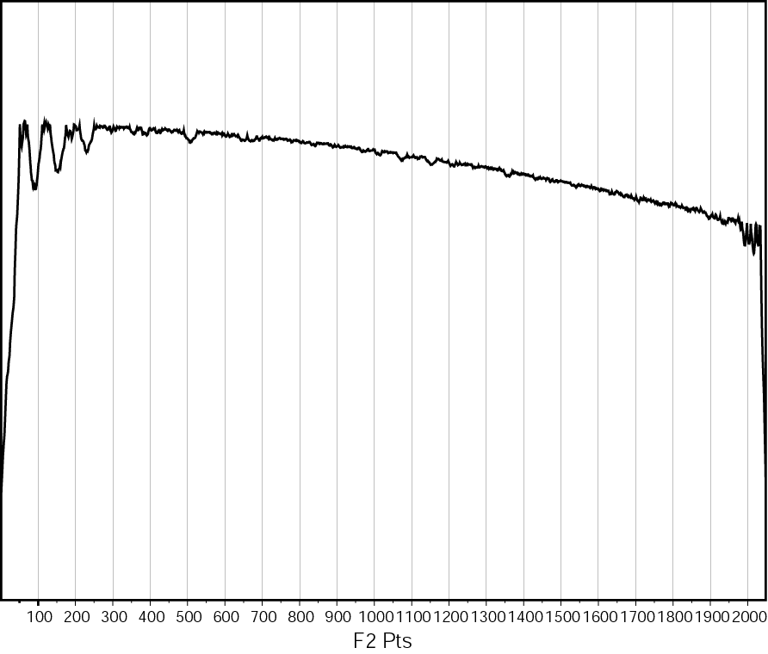
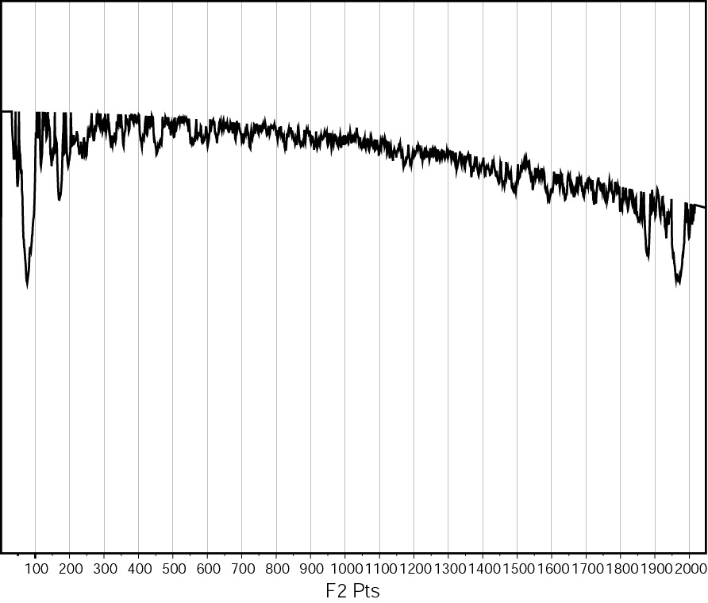
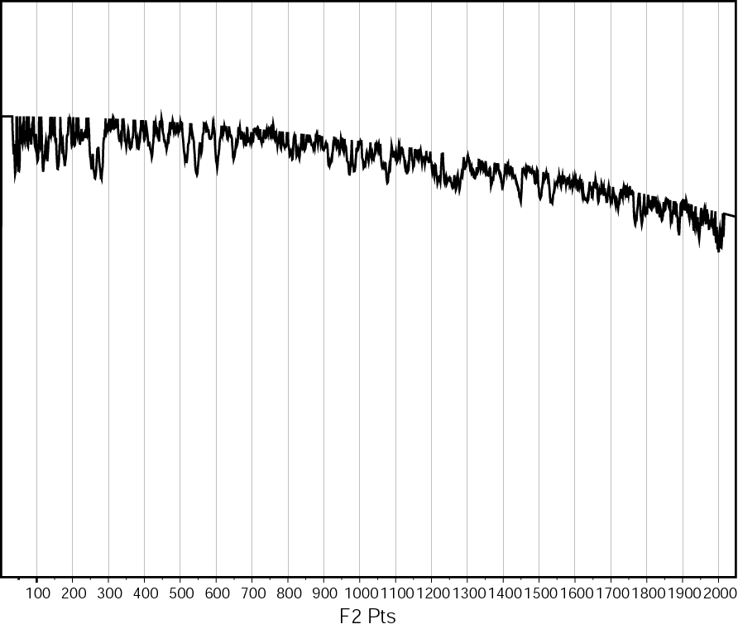
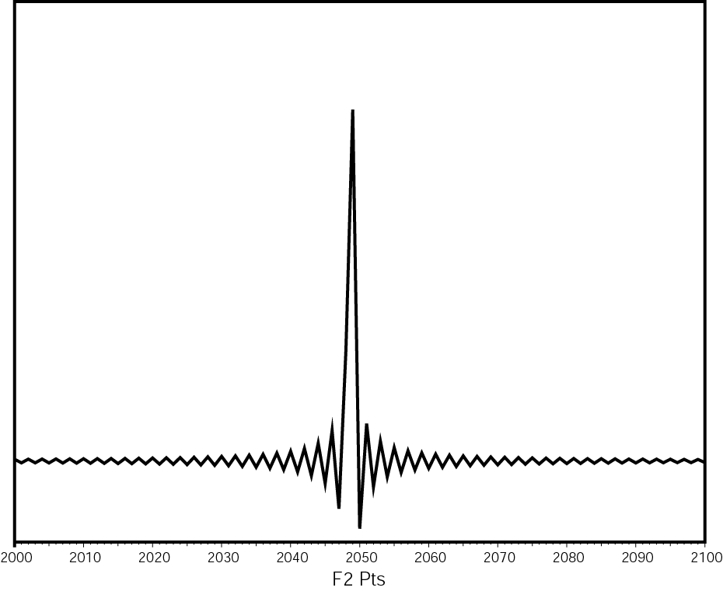
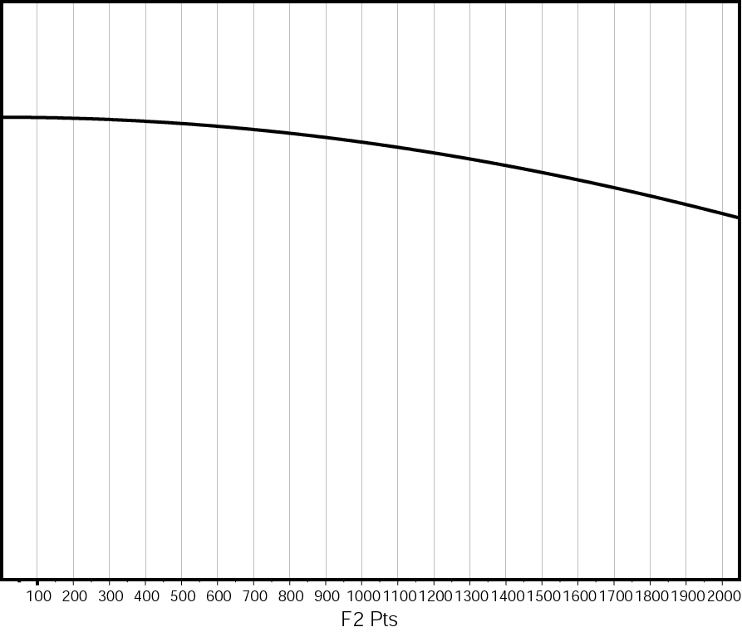
Optimizing sampling strategy
Time domain:
Simulated Signal (i) centered, but (ii) slightly off Nyquist Grid
Simulated Signal (i) centered, but (ii) slightly off Nyquist Grid
FM Reconstruction of 12.5% sampled 2048, modified random, seed 22
FM Reconstruction of 12.5% sampled 2048, modified random, seed 17
FM Reconstruction of 12.5% sampled 2048, purely random, seed 62
Time domain: for simplicity, only showing real part
real part
imaginary part

Slide 46
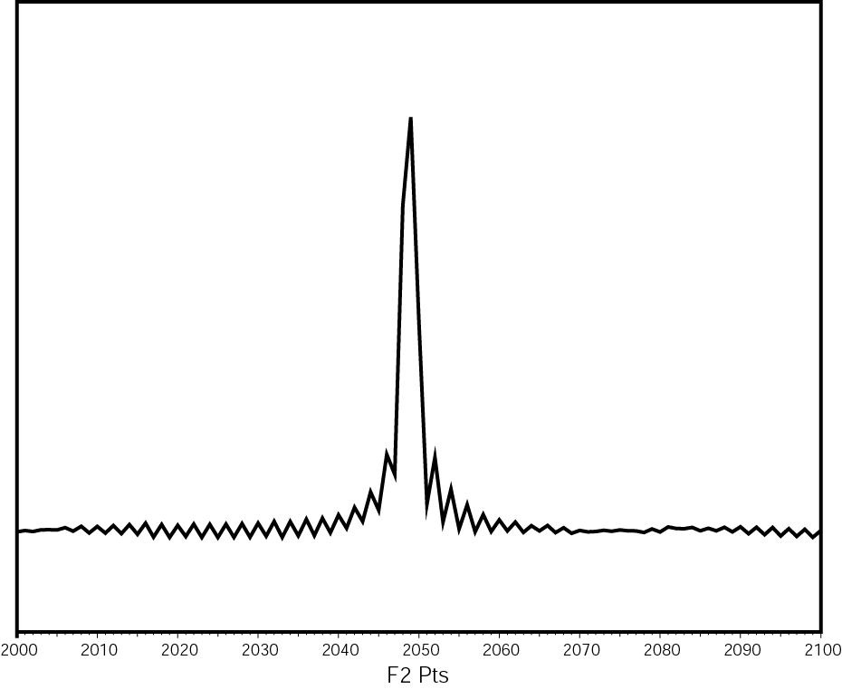
Different Seed values, Different result
“22”
“17”

Slide 47
Logging l₂ vs seed #
“l32ul32 – 12.5% of 2048”
“22”
“17”

Slide 48
Principle of “Distill” procedure

Slide 49
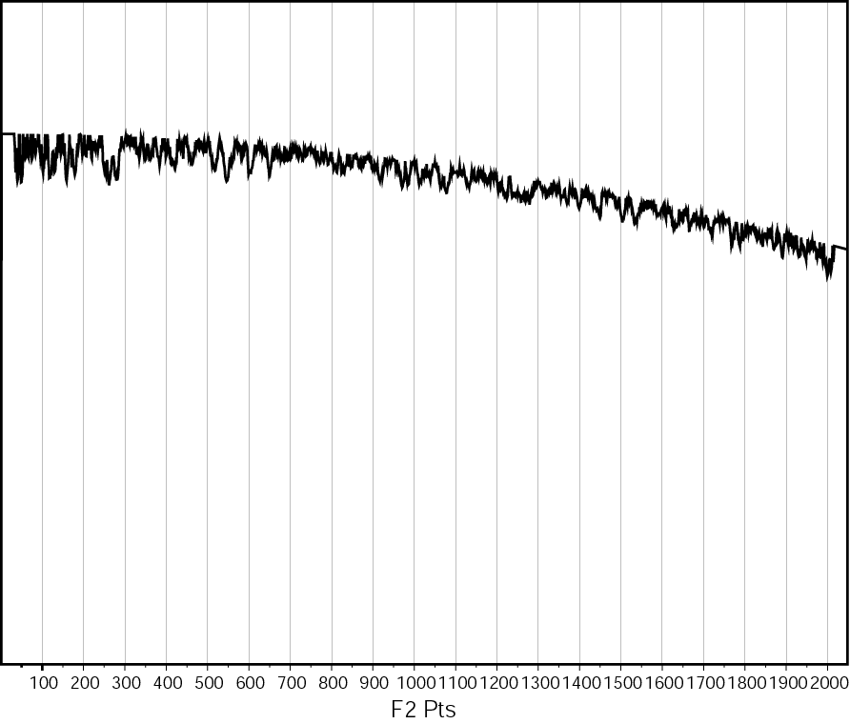
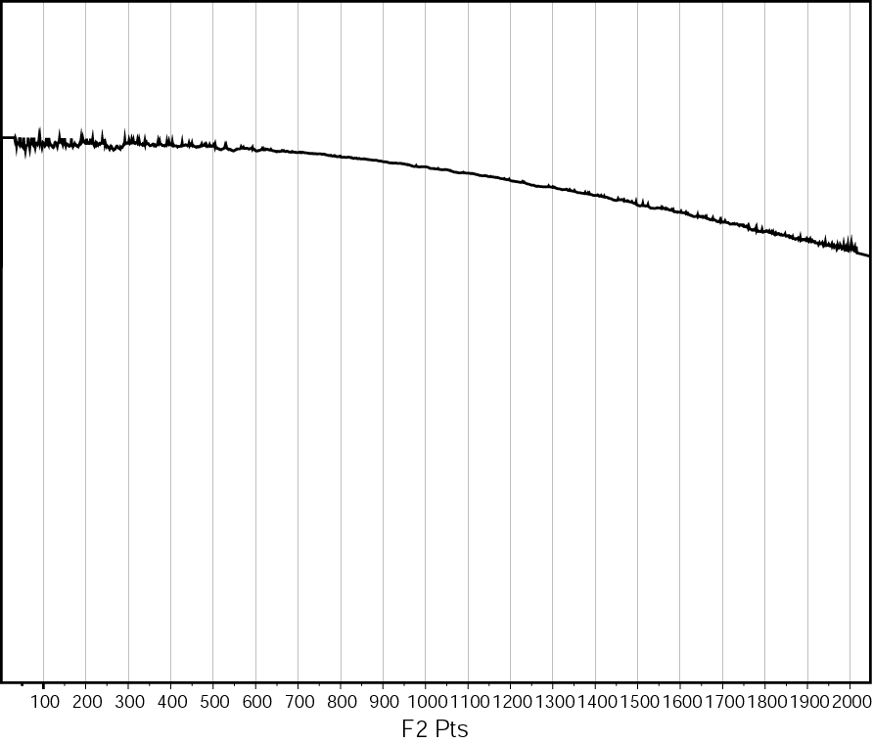
“Distill” improves fidelity – dynamic range
FM Reconstruction of 12.5% sampled 2048, modified random, seed 17
8 iterations of distill, l₂ = 398.41
FM Reconstruction of 12.5% sampled 2048, modified random, seed 17
1 iteration of distill, l₂ = 6331.80
FM Reconstruction of 12.5% sampled 2048, modified random, seed 17
No distill, l₂ = 13576.29

Slide 50
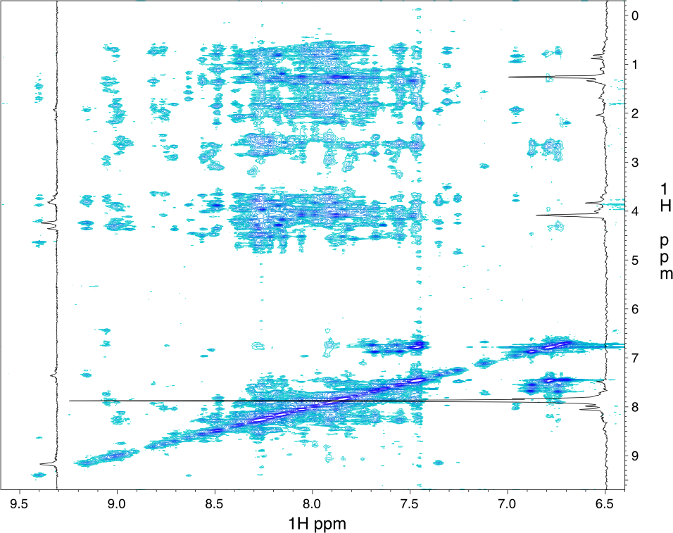
“Distill” improves fidelity – 2D Noesy of Kix domain
FM, 37% random
Ref, 512 complex
FM, 8 iter. Distill
Hyberts et al. J. Biomol. NMR 45(3) 2009

Slide 51
Quest: Is it possible to craft a sampling where fidelity not depending on seed# ?
Distill eliminates some, but is time consuming.
Observed:
big gaps of the sampling schedule are generally unfavorable
sizes required to be random to prevent folding
gaps at the beginning or end of the sampling are worse than in the middle
Long Sampling: Gaps distributed according to Poisson distribution

Slide 52
Hypothesis:
Enforcing Poisson distribution to the gap sizes yield better reconstruction results
In short, Poisson distribution is a Gaussian distribution, (binomial), “pushed to a wall” and only valid for positive integer values.

Slide 53
Features of Poisson Gap sampling
Calculate gap length on the fly
The overall probability f(k;λ) for a specific gap size k is assumed by a Poisson distribution:
λ is average gap length in Fourier grid
k is specific gap size
λ= 0.0 yields uniform sampling
λ= 1.0 creates a non-uniform schedule of 50% overall sampling density.
Sinusoidal Poisson Gap sampling: λ = λ₀ sin(θ)

Slide 54
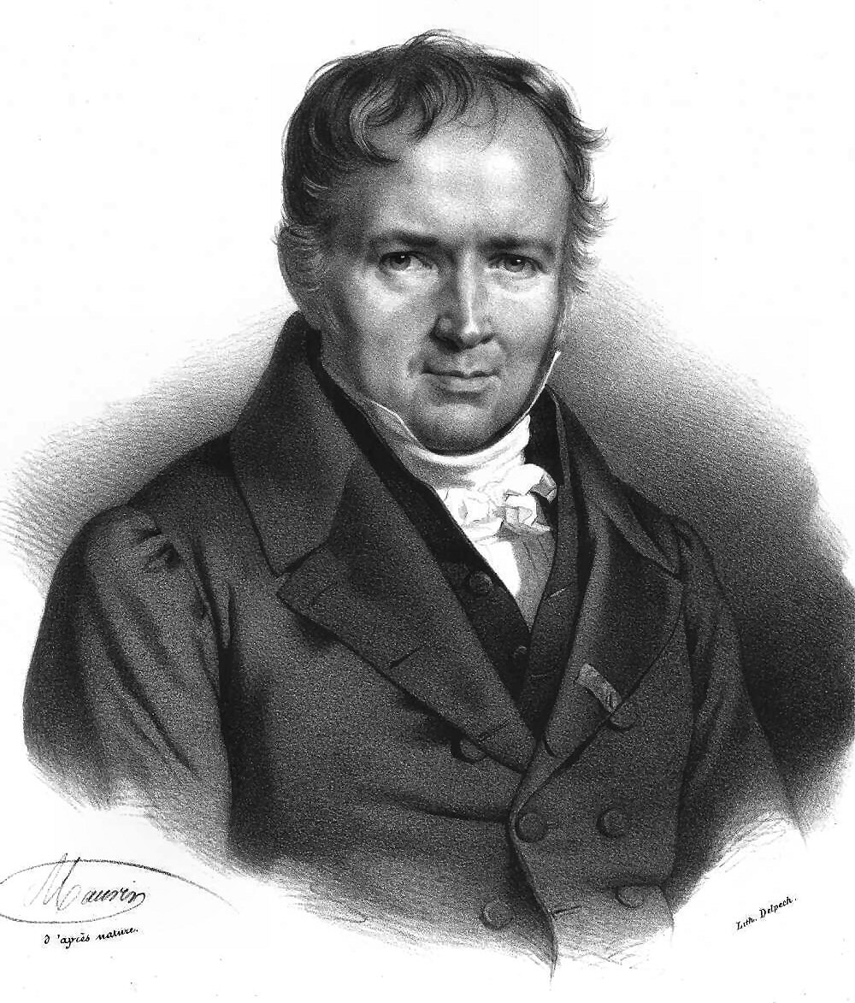
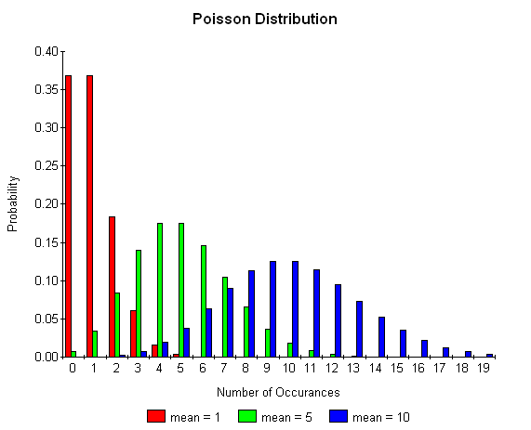
Poisson Distribution
Siméon Denis Poisson
Succeeded Fourier as Professor at École Polytechnique, Paris, France, 1806

Slide 55
Random generator: Poisson distribution
algorithm Poisson random number (Knuth): init: Let L ← e^{−λ}, k ← 0 and p ← 1. do: k ← k + 1. Generate uniform random number u in [0,1] p ← p x u. while p > L. return k − 1.
2
0
1
0
1
0
1
0
0

Slide 56
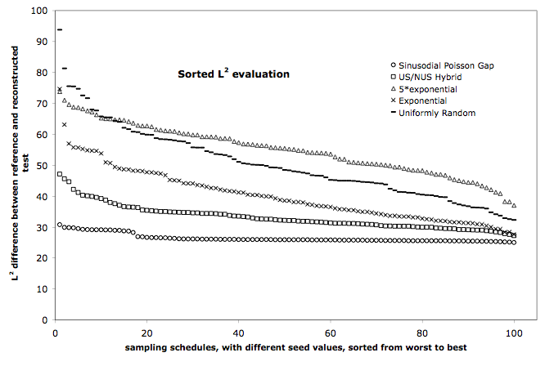
Logging l₂ vs seed # - different sampling strategies

Slide 57
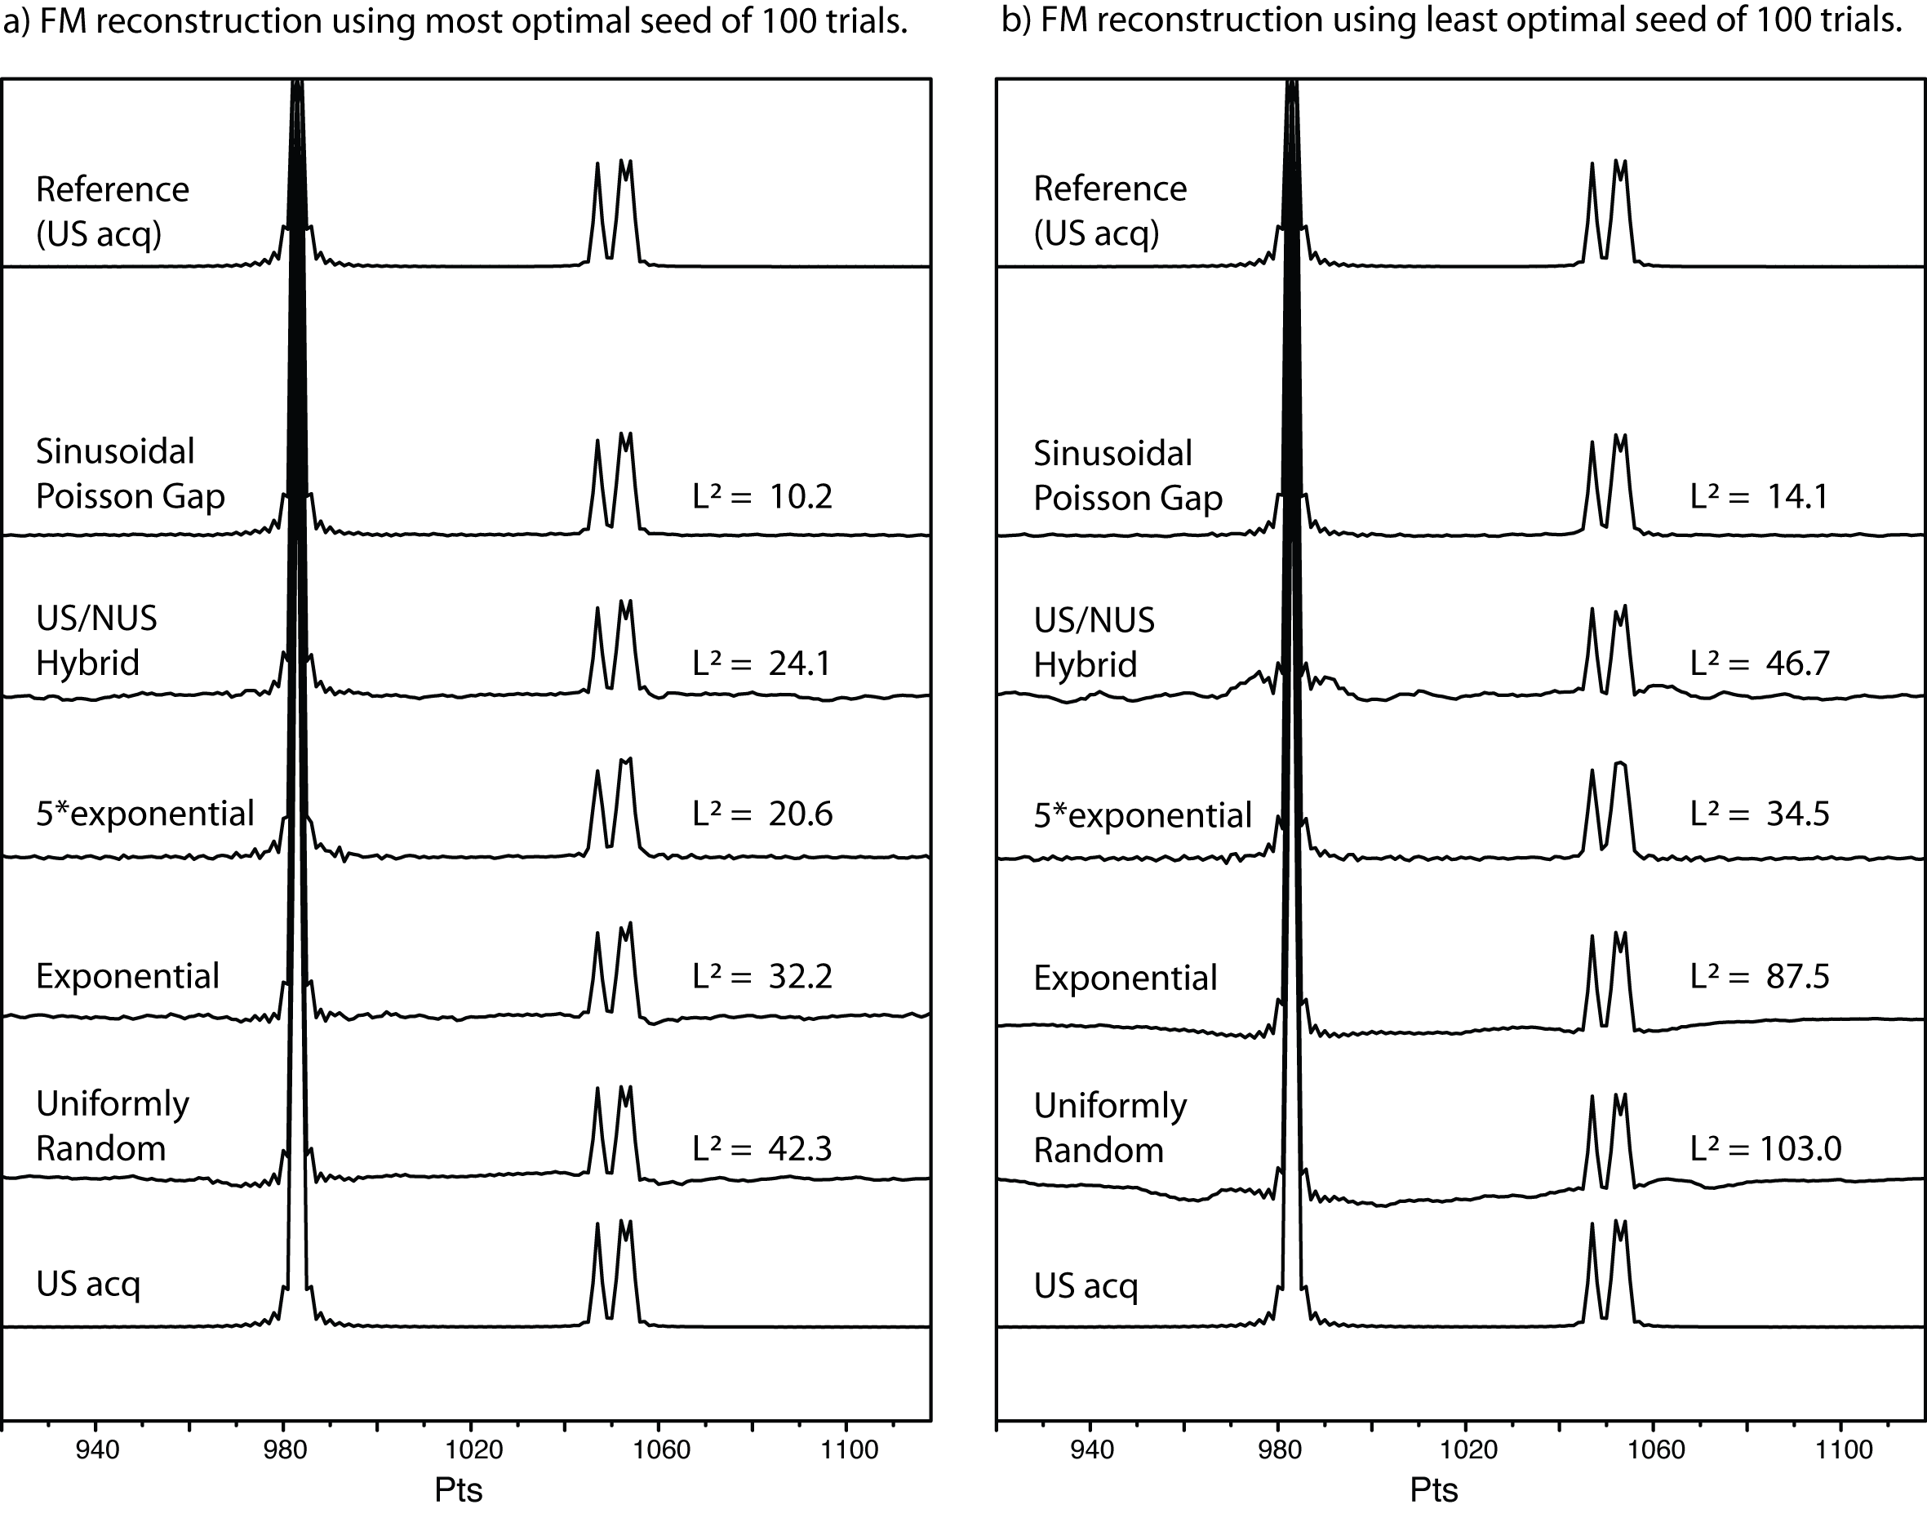
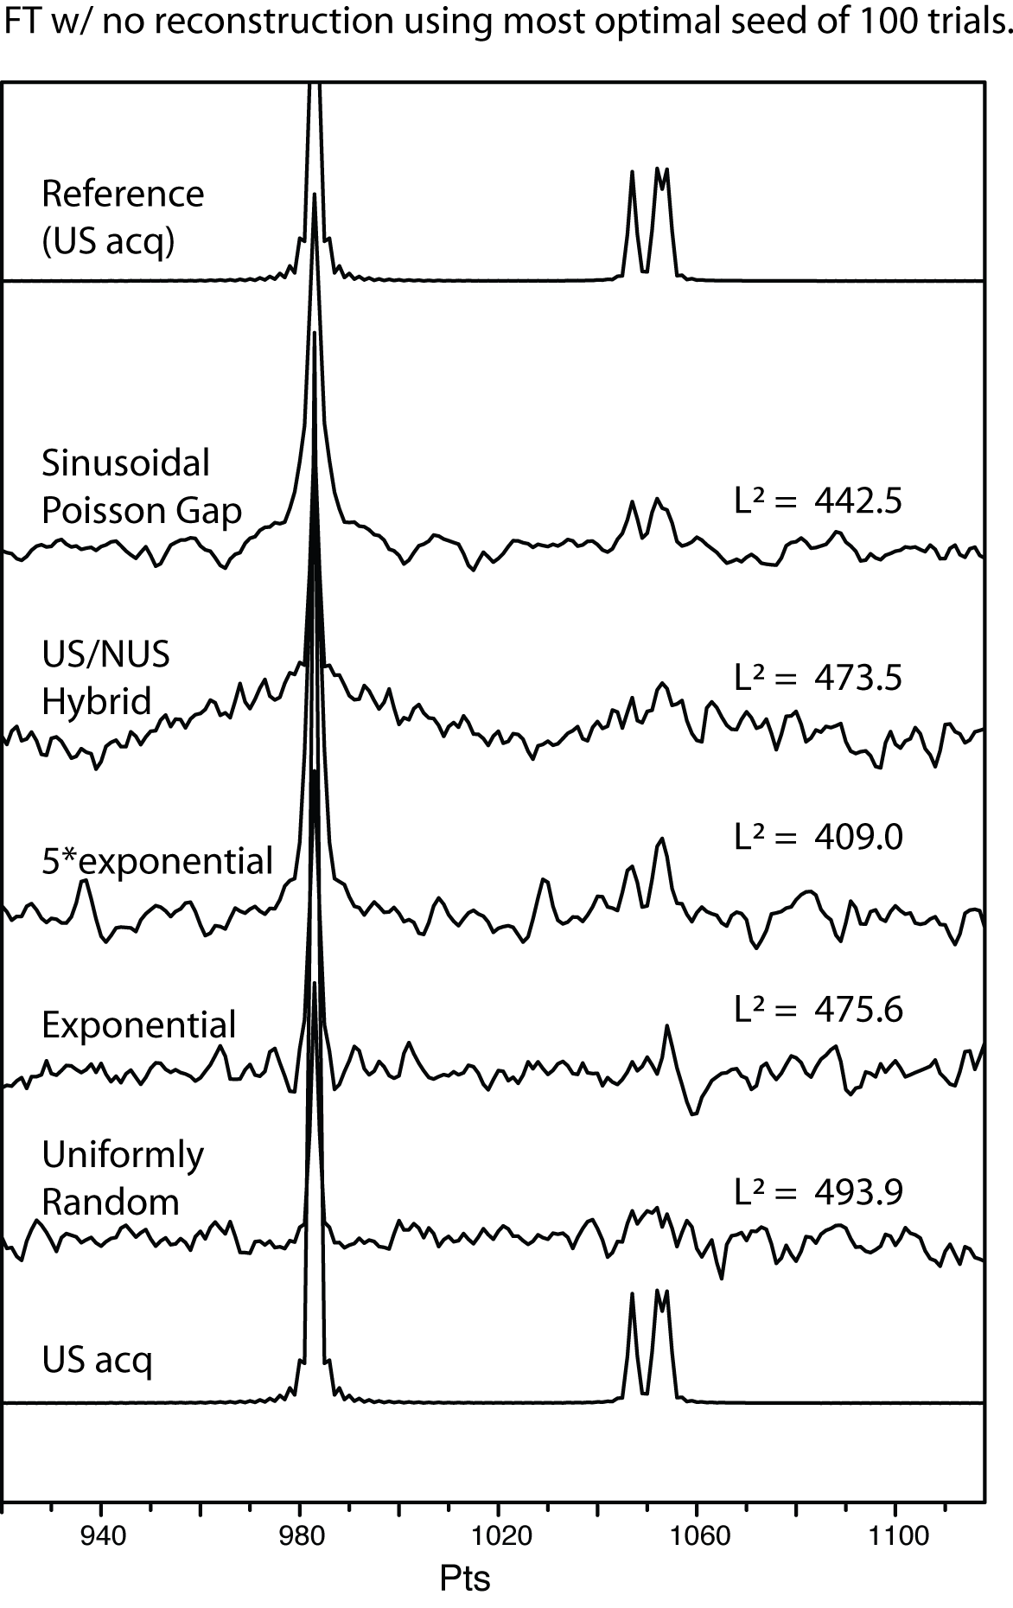
Poisson Gap sampling quality is virtually independent of seed #

Slide 58
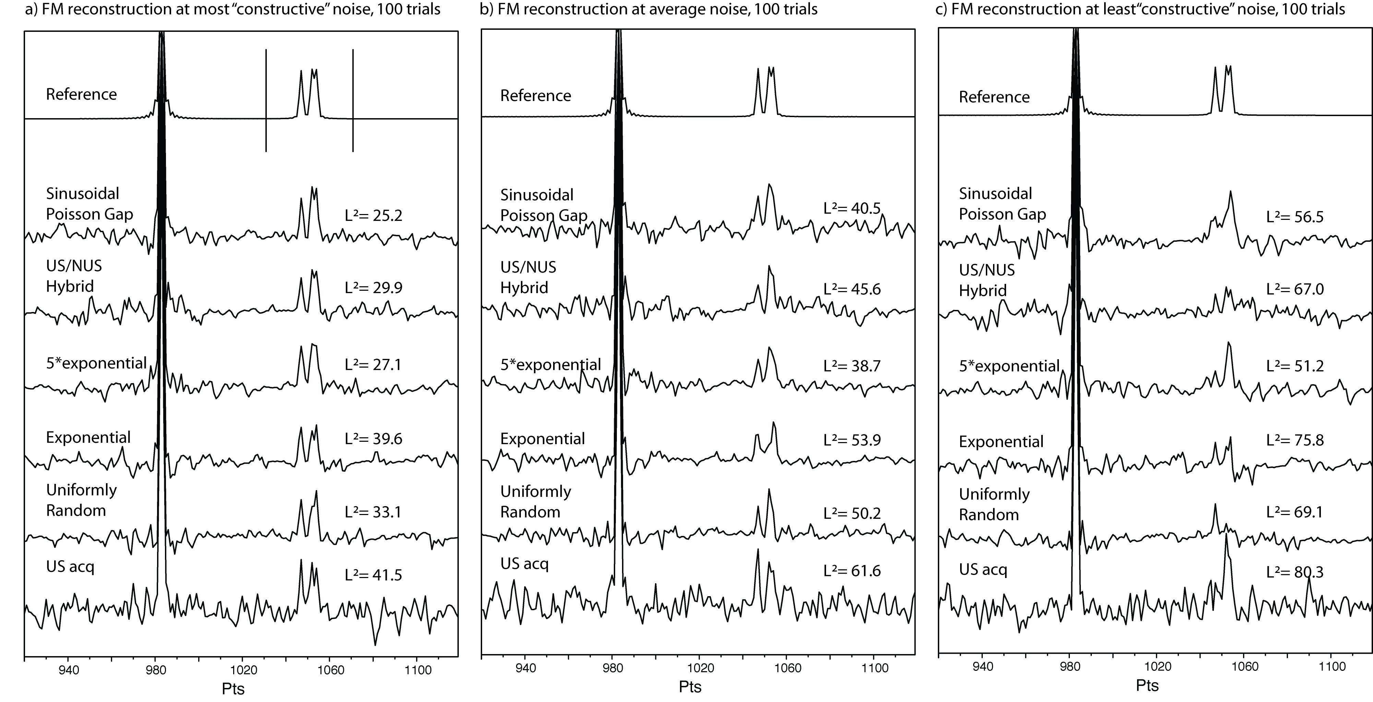
Poisson Gap sampling is stable also when noise is applied

Slide 59
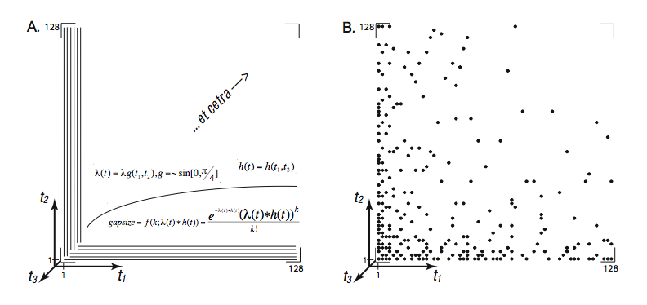
By “weaving”, the Poisson Gap sampling is extended into multiple dimensions

Slide 60
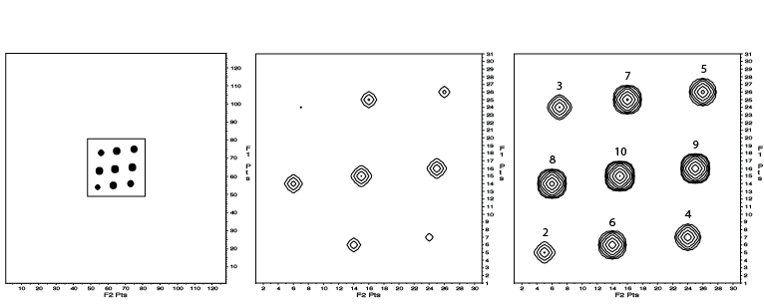
Validity, comparison in 2D NUS
32 x 32 points subgrid of a
128 x 128 points grid
1/16th sampled (6.25%)
Timeequivalent
Reference:
Best of 100 noise sets
Worst of 100 noise sets
Uniformly sampled
US/NUS Hybrid
Sinusoidal Poisson Gap
Uniformly sampled
US/NUS Hybrid
Sinusoidal Poisson Gap
L2=399
L2=84
L2=48
L2=547
L2=106
L2=75
Uniformly random
Exponential
5*Exponential
Uniformly random
Exponential
5*Exponential
L2=105
L2=67
L2=42
L2=130
L2=101
L2=65

Slide 61
Importance of a good sampling schedule
Non Poisson Gap schedule
Poisson Gap schedule

Slide 62
PoissonGap GUI Implemented for use up to 4 dimensions
JAVA program to calculate NUS schedules based on Poisson Gap strategy

Slide 63
Possible to gain Sensitivity?

Slide 64
Is it possible to get something for from nothing?
NUS does not in itself give more sensitivity – in the same time units the power of the signal and the noise stay the same independent sampling!
However:
SNR in NMR does not consider power for the signal, but signal intensity,
And, if the reconstruction method provide a model of identify signals, the practical sensitivity is enhanced
And, finally, NUS allows for more effective sampling of the data, where the signal is more pronounced!

Slide 65
NUS sensitivity gain for CaN HSQC like spectra
K. Takeuchi
Hyberts et al. J. Am. Chem. Soc., 132(7), 2010

Slide 66
SNR is “easy” to define

Slide 67
SNR is non-intuitive for NUS

Slide 68
Noise distribution is different US/NUS! N.B. Time-equivalent
100% US
10% NUS
25% NUS

Slide 69
Noise “on top of signals” / SNR(rms) not reliable
 | Peak #1 288 | Peak #2 144 | Peak #3 72 | Peak #4 36
100% US SNR Height | 281.3 ± 6.2 287.9 ± 6.9 | 140.6 ± 6.2 144.1 ± 6.4 | 76.5 ± 6.2 71.8 ± 6.1 | 28.3 ± 6.2 35.5 ± 6.2
25% NUS SNR Height | 284.3 ± 2.7 287.0 ± 5.0 | 136.6 ± 2.7 143.2 ± 5.9 | 66.8 ± 2.7 67.1 ± 5.7 | 26.9 ± 2.7 31.3 ± 6.6
10% NUS SNR Height | 287.5 ± 1.2 291.6 ± 6.8 | 148.1 ± 1.2 138.7 ± 6.0 | 60.7 ± 1.2 64.9 ± 6.4 | 38.0 ± 1.2 22.9 ± 7.0

Slide 70
Defining sensitivity
If we define sensitivity as the probability of identifying very small peaks -
then we can simply run the same experiment multiple times (e.g. 100 times) and check the probability.
Is it possible to get more sensitivity and keeping the resolution?

Slide 71
Probability of detecting signal at various signal strengths (noise constant)

Slide 72
S-curve yield a measure of sensitivity
Sensitivity gain when S-curve is moved to the left in plot
Whole line = Uniform Sampling
Dashed lines = Various forms of time equivalent Non-Uniform Sampling

Slide 73
NUS brings sensitivity gain for certain situations

Slide 74
Practical Implementation

Slide 75
2D: fid.com
#!/bin/csh
bruk2pipe -in ./ser \
-bad 0.0 -noaswap -DMX -decim 24 -dspfvs 12 -grpdly 0 \
-xN 2048 -yN 128 \
-xT 1024 -yT 64 \
-xMODE DQD -yMODE Echo-AntiEcho \
-xSW 7002.801 -ySW 1824.568 \
-xOBS 500.132 -yOBS 50.684 \
-xCAR 4.769 -yCAR 118.066 \
-xLAB HN -yLAB 15N \
-ndim 2 -aq2D States \
-out ./test.fid -verb -ov

Slide 76
2D: ft12.com
#!/bin/csh
nmrPipe -in test.fid \
| nmrPipe -fn SOL \
| nmrPipe -fn SP -off 0.5 -end 0.98 -size 512 -c 0.5 \
| nmrPipe -fn ZF -size 1024 \
| nmrPipe -fn FT -auto \
| nmrPipe -fn PS -p0 90.0 -p1 0.0 -di \
| nmrPipe -fn EXT -left -sw -verb \
| nmrPipe -fn TP \
| istHMS_20121112_64b –xN 256 -sched ./sched.1d -itr 500 \
| nmrPipe -fn SP -off 0.5 -end 0.98 -c 0.5 \
| nmrPipe -fn ZF -auto \
| nmrPipe -fn FT -auto \
| nmrPipe -fn PS -p0 -90.0 -p1 0.1 -di -verb \
| nmrPipe -fn POLY -ord 0 -auto \
| nmrPipe -fn TP \
| nmrPipe -fn POLY -ord 0 -auto \
-ov -out test.ft2

Slide 77
3D: fid.com
#!/bin/csh
bruk2pipe -in ./ser \
-bad 0.0 -noaswap -DMX -decim 24 -dspfvs 12 -grpdly 0 \
-xN 2048 -yN 4 -zN 818 \
-xT 1024 -yT 4 -zT 818 \
-xMODE DQD -yMODE Real -zMODE Real \
-xSW 8012.821 -ySW 1824.818 -zSW 4032.258 \
-xOBS 500.132 -yOBS 50.684 -zOBS 125.764 \
-xCAR 4.772 -yCAR 119.571 -zCAR 54.082 \
-xLAB HN -yLAB 15N -zLAB 13C \
-ndim 3 -aq2D States \
| nmrPipe -fn MAC -macro $NMRTXT/ranceY.M -noRd -noWr \
| pipe2xyz -x -out ./fid/test%03d.fid -verb -ov -to 0

Slide 78
4D: fid.com
#!/bin/csh
bruk2pipe -in ./ser \
-bad 0.0 -noaswap -DMX -decim 24 -dspfvs 12 -grpdly 0 \
-xN 2048 -yN 8 -zN 10906 -aN 0 \
-xT 1024 -yT 8 -zT 10906 -aT 0 \
-xMODE DQD -yMODE Real -zMODE Real -aMODE Real \
-xSW 6666.667 -ySW 500.130 -zSW 1257.585 -aSW 1257.585 \
-xOBS 500.130 -yOBS 500.130 -zOBS 125.760 -aOBS 125.760 \
-xCAR 4.725 -yCAR 0.600 -zCAR 22.100 -aCAR 26.221 \
-xLAB Hdir -yLAB Hnoe -zLAB Cnoe -aLAB Cdir \
-ndim 3 -aq2D States \
| pipe2xyz -x -out ./fid/test%05d.fid -verb -ov -to 0

Slide 79
4D: ft1.com
#!/bin/csh
xyz2pipe -in fid/test%05d.fid -x -verb \
| nmrPipe -fn SP -off 0.5 -end 0.98 -pow 1 -c 0.5 \
| nmrPipe -fn ZF -auto \
| nmrPipe -fn FT \
| nmrPipe -fn PS -p0 -195 -di \
| nmrPipe -fn EXT -x1 950 -xn 1125 -sw \
| pipe2xyz -ov -out ft1/test%05d.ft1 -x
swap:
xyz2pipe -in ft1/test%05d.ft1 | nmrPipe -fn ZTP -verb \
| nmrPipe -fn TP | pipe2xyz -ov -out yzx/test%03d.nus
alternative_swap:
xyz2pipe -in ft1/test%05d.ft1 \ | pipe2xyz -ov -out yzx/test%03d.nus-z

Slide 80
4D: ist.com
#!/bin/csh
foreach F ( ./yzx/test*.nus )
echo $F
istHMS -in $F -incr 1 \
-dim 3 –autoN 1 -user 1 \
-itr 400 -i_mult 0.98 -e_mult 0.98 \
-ref 0 -sched ./sched.3D \
-out $F:r.rec
end
-autoN 1 = -xN 60 -yN 150 -zN 150 (from schedule)

Slide 81
4D: phf.com
#!/bin/csh
xyz2pipe -in yzx_1/test%03d.rec \
| phf2pipe -user 1 \
-xproj xa.ft2 -yproj ya.ft2 -zproj za.ft2 \
-verb 0 \
> test.ft1

Slide 82
4D: phasing
Use the files
xa.ft2
ya.ft2
za.ft2
in NMRPipe

Slide 83
4D: ft234.com
#!/bin/csh
cat test.ft1 \
| \
| <typical NMRPipe processing current x-dim > \
| \
| nmrPipe –fn TP \
| \
| <typical NMRPipe processing current y-dim > \
| \
| nmrPipe –fn TP \
| nmrPipe –fn ZTP \
| \
| <typical NMRPipe processing current z-dim > \
| \
| nmrPipe –fn ZTP \
> test.ft4

Slide 84
Conclusions
IST reconstruction:
is fast enough and very similar to FM in reliability
allows for some degree of extrapolation.
Implementation easy enough for people in the lab to use the software.
We consider Poisson Gap sampling our best way of NUS; algorithm implemented in a JAVA GUI.
NUS as rule of thumb 4* per dimension (conservative estimate); better and more stable than LP.
S-curve plots allow us to investigate sensitivity directly.
Sensitivity gain can be proven when using NUS.
Acknowledgments: Dominique Frueh, Haribabu Arthanari, Alexander Milbradt, Scott Robson, Koh Takeuchi, Gregory Heffron, Jeff Hoch, Gerhard Wagner

